Slide 1
Notes:
Introduce myself
Atlantic Center for the Arts has a rich cultural legacy since its founding by Doris Leeper in 1977.
It brings together the world’s greatest painters, composers, writers and choreographers to live and work during a residency on our 68-acre campus in New Smyrna Beach.

Slide 2
ACA Inspire Video

Slide 3
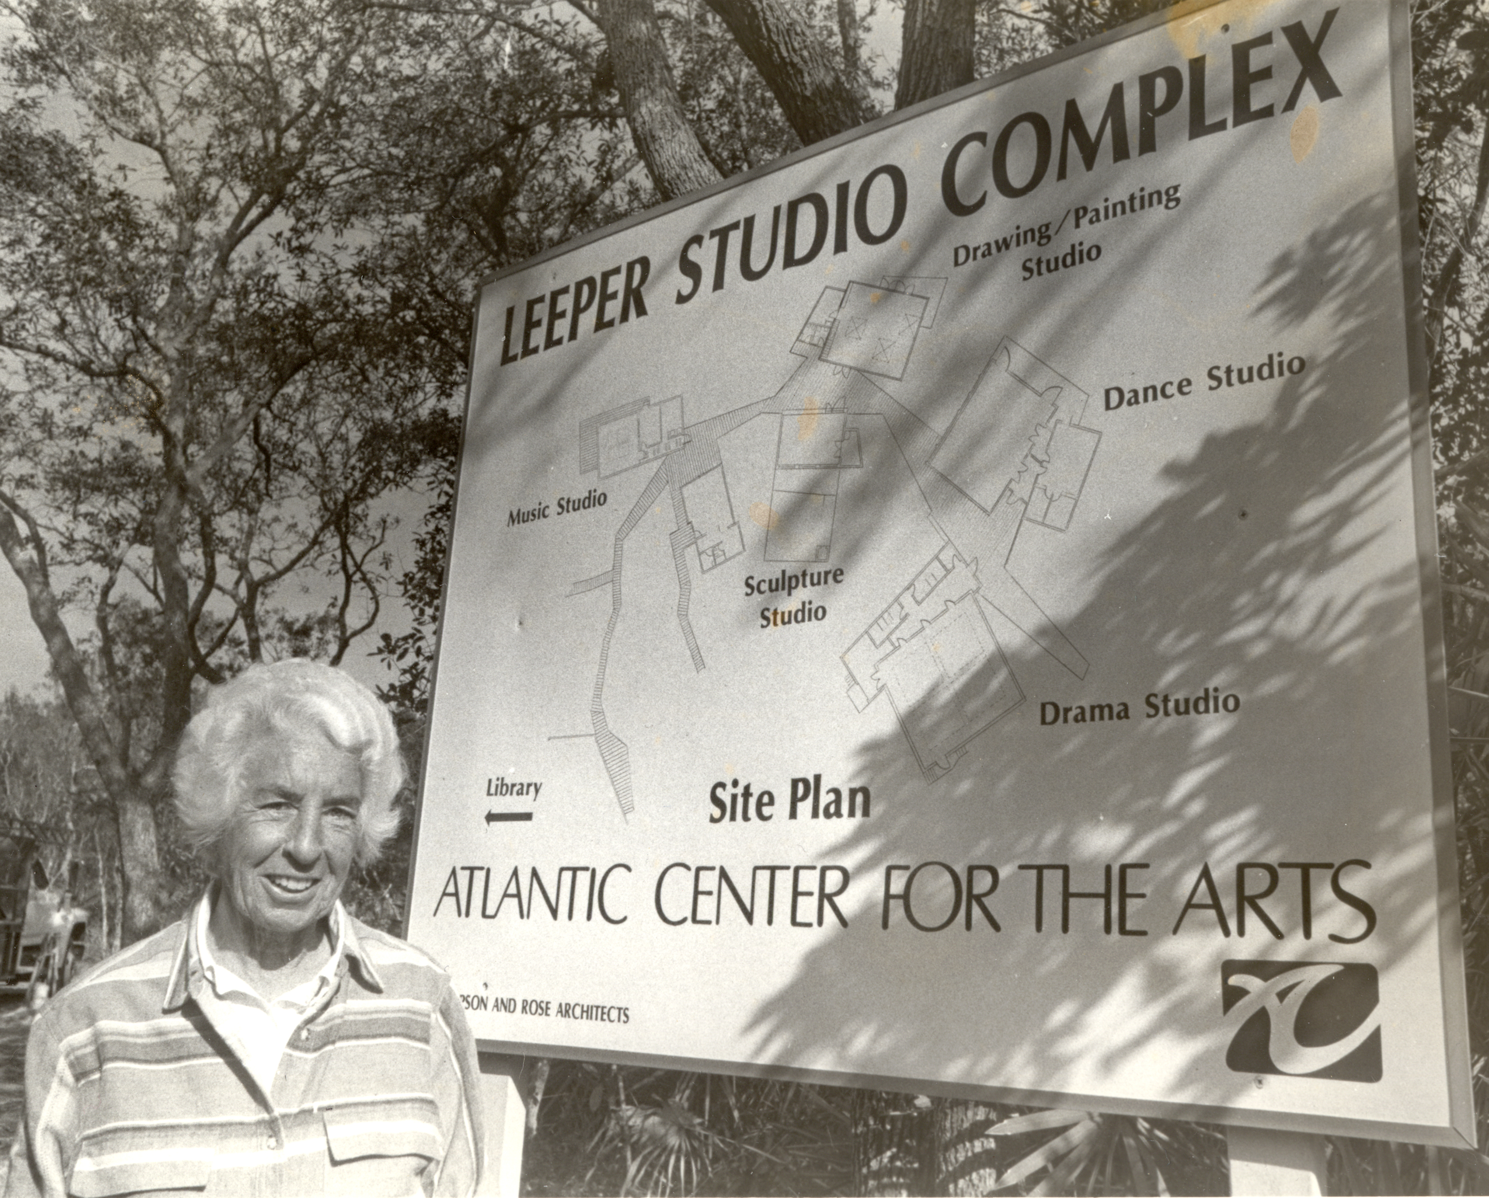
Notes:
Doris Leeper our founder saw a need and wanted to create the opportunity for Artists to collaborate and communicate from different disciplines, so the seed for ACA was born.
ACA was one of the first residencies to offer this model, prior to this most artists worked in solitude or as a group within the same discipline.
The concept of Master Artists from 3 different disciplines and each selecting their associate artists has been in practiced since the first residency in 1982.
No staff or committee is involved in the selection process.
Basically the Master Artist is curating their own residency experience
Here are some key points about how ACA is different from other residencies
Our residency offers a mentorship experience
Opportunity to collaborate with different disciplines
We are a group setting, so if you seek to work in solitude our residency would not be a good fit since there about 30 people participating in the residency
4. MA curate their own experience in the selection process of the Associate Artists.
5. Some residencies require artists to donate work in exchange for some compensation, we don’t.
We are about the process, so if you just want to think, read, research and sleep that is acceptable
This is the site map of ACA
We have the Pabst Visitor Center and Gallery, and in the same building our Administration offices are located
Leeper Studio complex is the winner of eight national architectural awards:
library
A field house,
A music studio,
A painting studio,
A sculpture studio,
A dance studio,
a writer’s studio and
a black box theater
We also have a “commons” on our property, where artist gather to eat their 3 meals a day prepared by our chef.
All Artist have 24 access to the studios for the 3 weeks
There are 28 housing units on the property to accommodate the Associate Artists.
Each housing unit is about the size a motel room that include a personal bathrooms with showers, a full-size bed, a desk with chair, and a small refrigerator

Slide 4
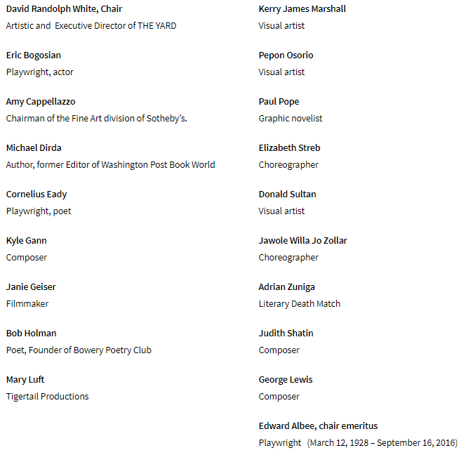
ACA’s National Council:
How are Artists selected to mentor a residency at ACA?
Notes:
How are Master Artists selected?
-Potential Master Artists are recommendations from our National Council and former participants who believe these artists are making great strides in all aspects of the arts both nationally and internationally
- This a current list of names that make up our National Council.

Slide 5
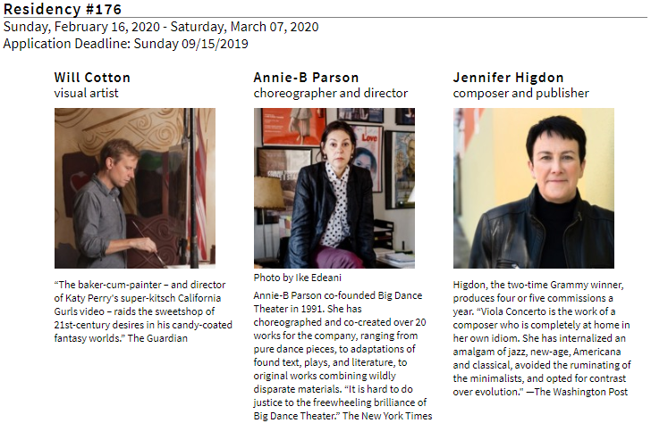
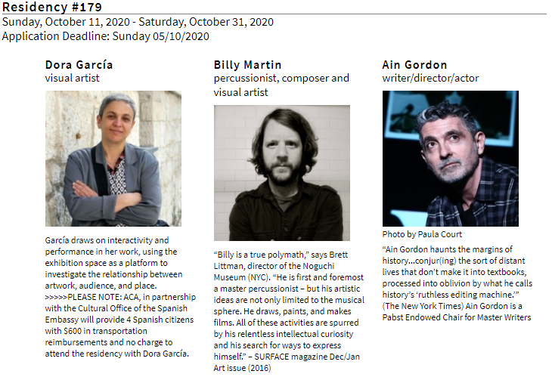
Notes:
- Once we determine they are a good fit for our program we send letters of invitation and start scheduling the calendar year 2 years in advance.
In the letters we explain to the Master Artist, monetary compensation for their time, accommodations we offer; such as a cottage, and what is expected of them during their residency such as community outreaches.
Expectation that Artists meet as a group or individually a minimum of 2 hours a day except on weekends
The Master Artist bio’s and their criteria for selecting artists to work with them are on our website, atlanticcenterforthearts.org.
This page represents what our year WOULD have looked like without COVID – the two summer residencies were cancelled, and we have rebooked those MA into 2021 and 2022.

Slide 6
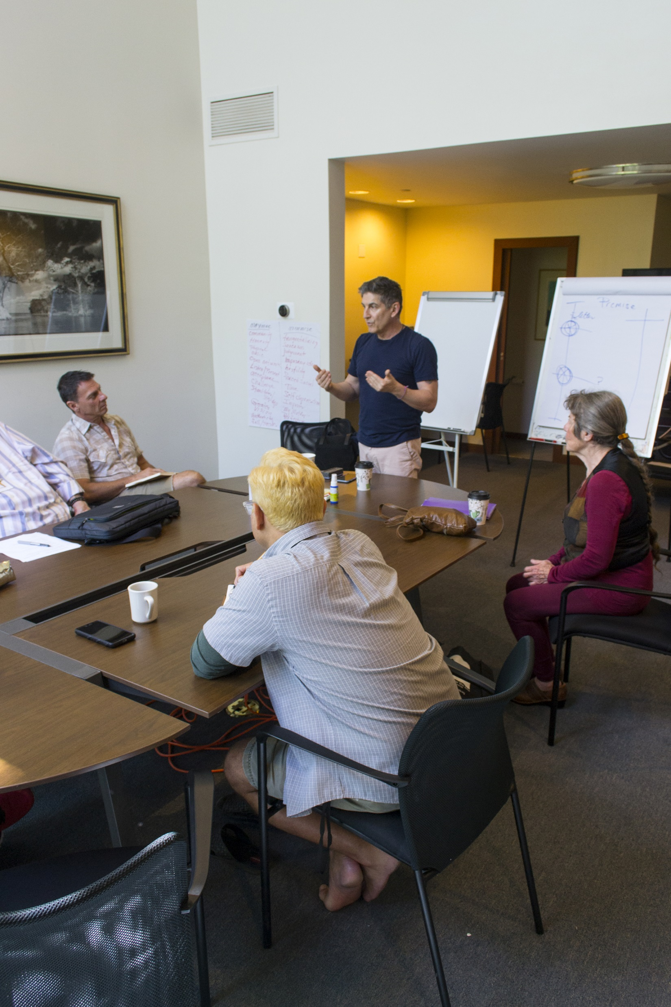
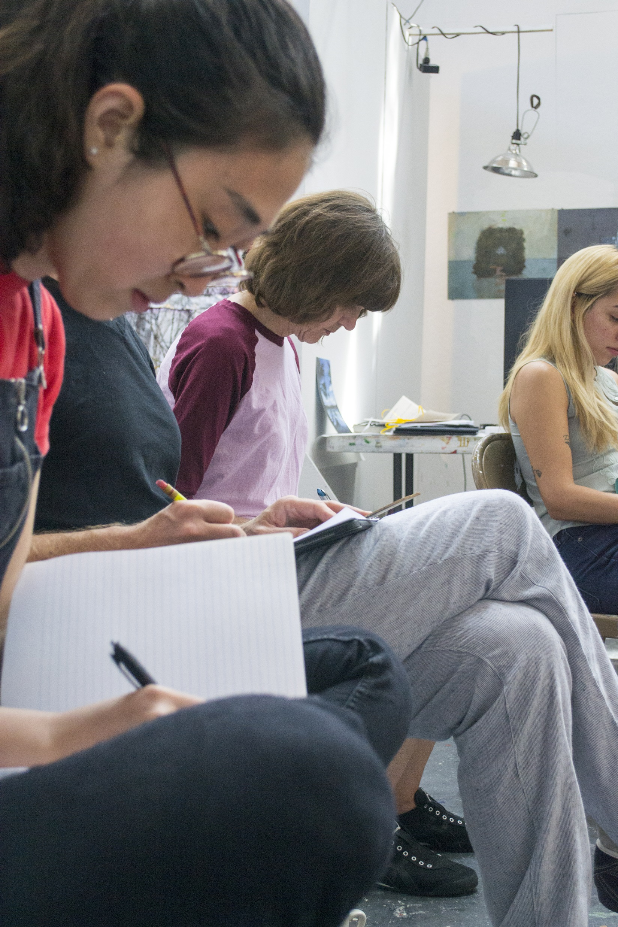
How are Associate Artists selected?
Notes:
How are the Associate Artists selected?
First the Artist must fill out an online application via Submittables.
Anyone in the world can apply that is over the age of 21 but they must be able to speak English
The MA will then select 8 Associate artists (6 now due to COVID) and 4 alternates from the pool of applicants.
The selection process is subjective and determined by the MA
Once the artists are selected, they are given the title of Associate Artist
The residency fee is $900 for the full 3 weeks; we offer full financial aid once you have been accepted into the residency
Associate Artists ages range from 21 to 70
The artists come from different backgrounds such as college grads, mid-career artists, university professors

Slide 7
Notes:
In 1990 the MacArthur Foundation advocated for the creation of the Alliance of Artists Communities. ACA was one of the 18 organizations selected for this incentive and is current member
Their mission “Cooperate to improve the environment in which we support the creative process.”
The Alliance of Artists Communities first meeting took place at Atlantic Center for the Art in February 1991
In 1996 there were 69 artist communities in the US
Currently it is estimated there are 500 artists’ communities in the US and more than 1.500 worldwide
Alliance of Artist Communities convenes yearly in different locations across the US

Slide 8
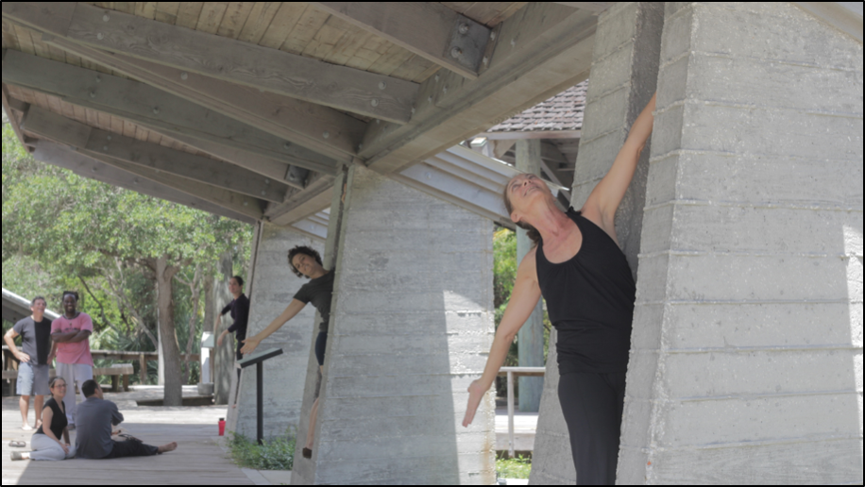
Join the journey, support a culture of creativity!
Notes:
You can learn more about Residency Program and our other programming on our website: atlanticcenterforthearts.org. You can also find us on various social media outlets, and if you text the letters ACA to the number 42828 you will start receiving our monthly newsletter.
Join the journey, support a culture of creativity!

