Slide 1
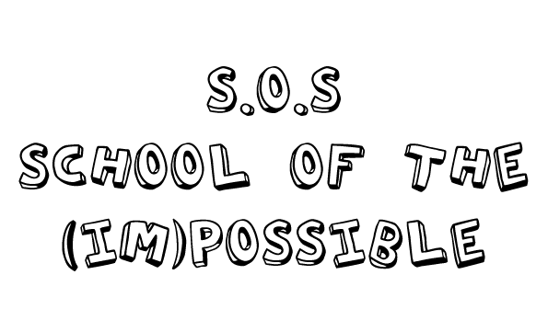
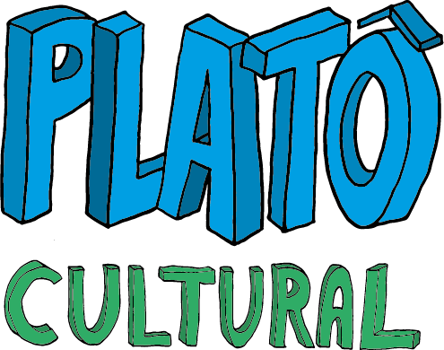
Francine Kliemann and Márcia Donadel

Slide 2
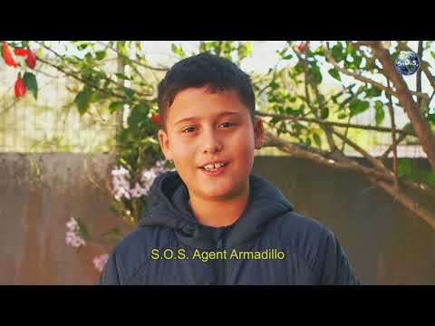

Slide 4
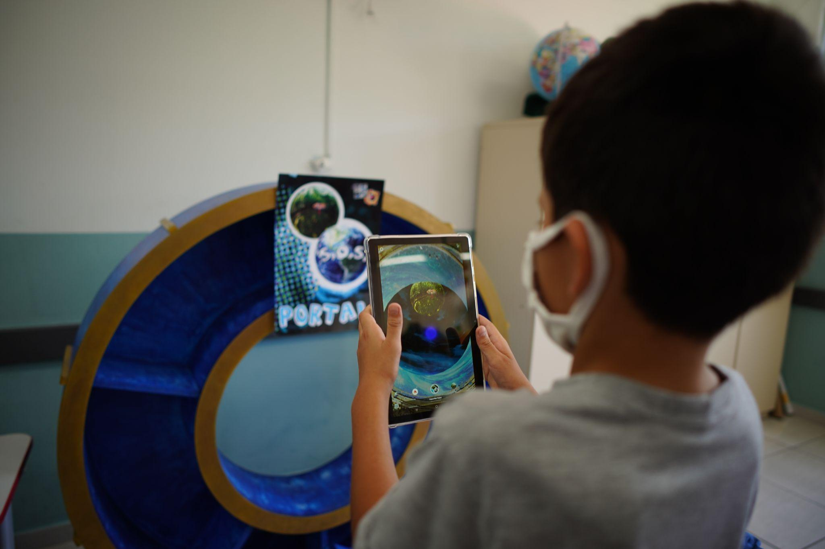
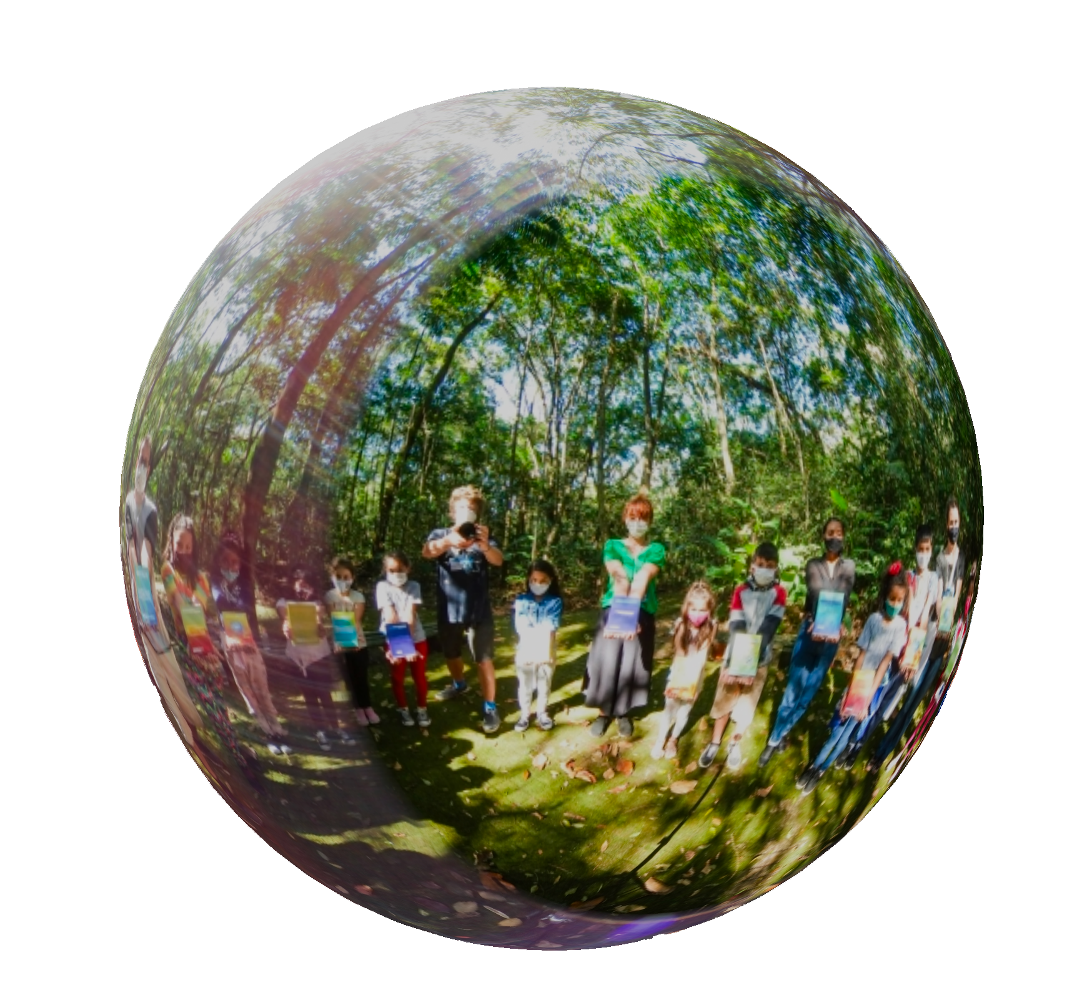

Slide 5
“ What if S.O.S, an organisation from the future, found a way to communicate with our time? What if they invited our children to embark on an (Im)possible mission to save our planet ?

Slide 6
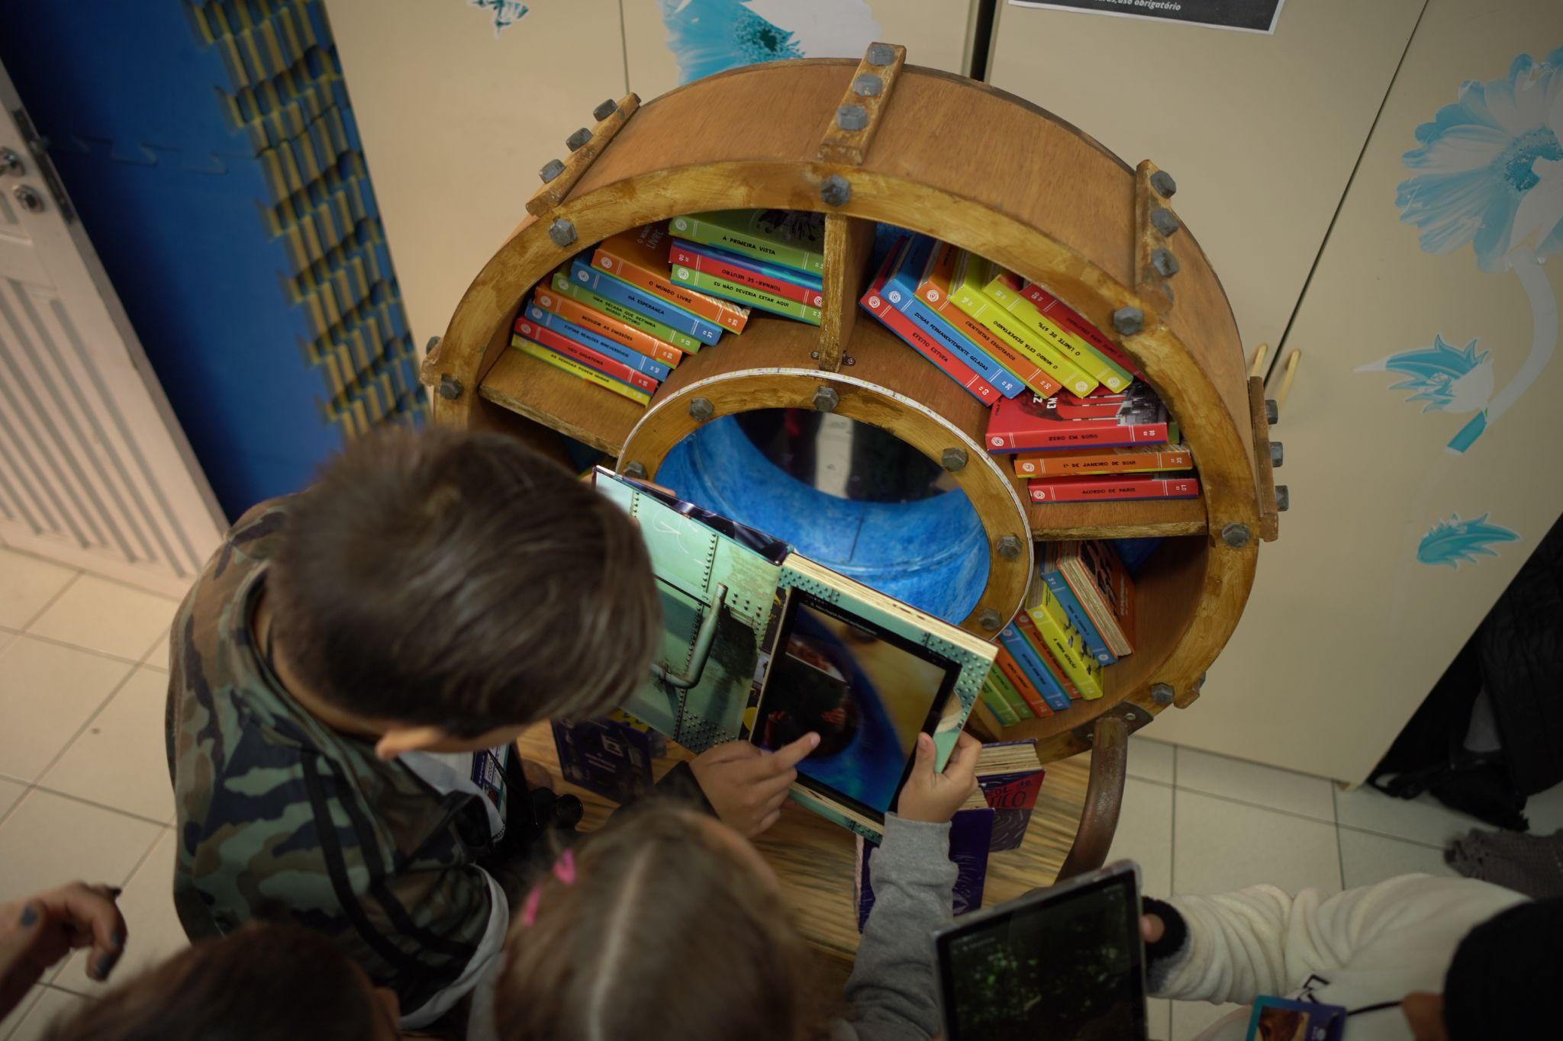

Slide 7
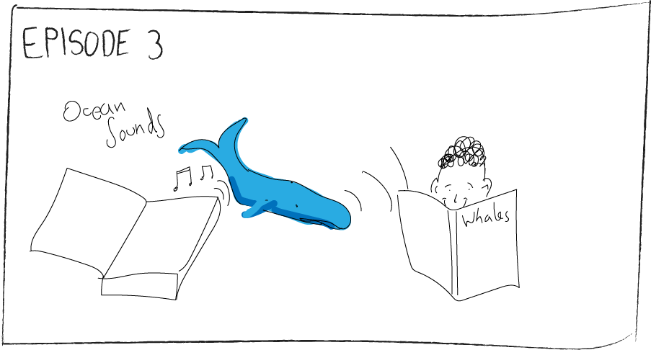
THE PROCESS
Co-creation
Supportive global network
Measuring impact
How artistic work creates social impact
Shaping creative process

Slide 8
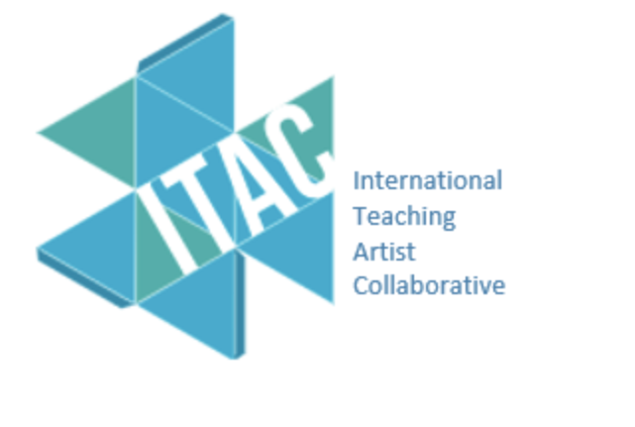
2021/22
02
COUNTRiES: Brazil and Scotland
CITIES: São José and Wishaw
06
Schools
15
Cohorts
375
students

Slide 9
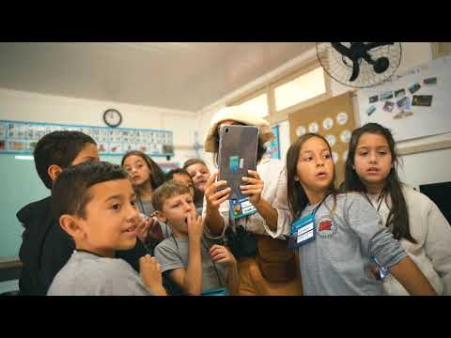

Slide 10
THE PROJECT
Immersing in the fictional world, reconnecting with the real world.
Fine line between Imagination and Reality
Agents of S.O.S - Agents of Change
Empowerment through imagination and play

Slide 11
THE PROJECT - LEARNING ADVENTURES
A CREATIVE APPROACH TO TEACHING AND LEARNING
Art as a means, as a way of doing.
Learning as a natural part of the childhood world
Protagonists explore, discover and make sense of what they learn
The power of play

Slide 12
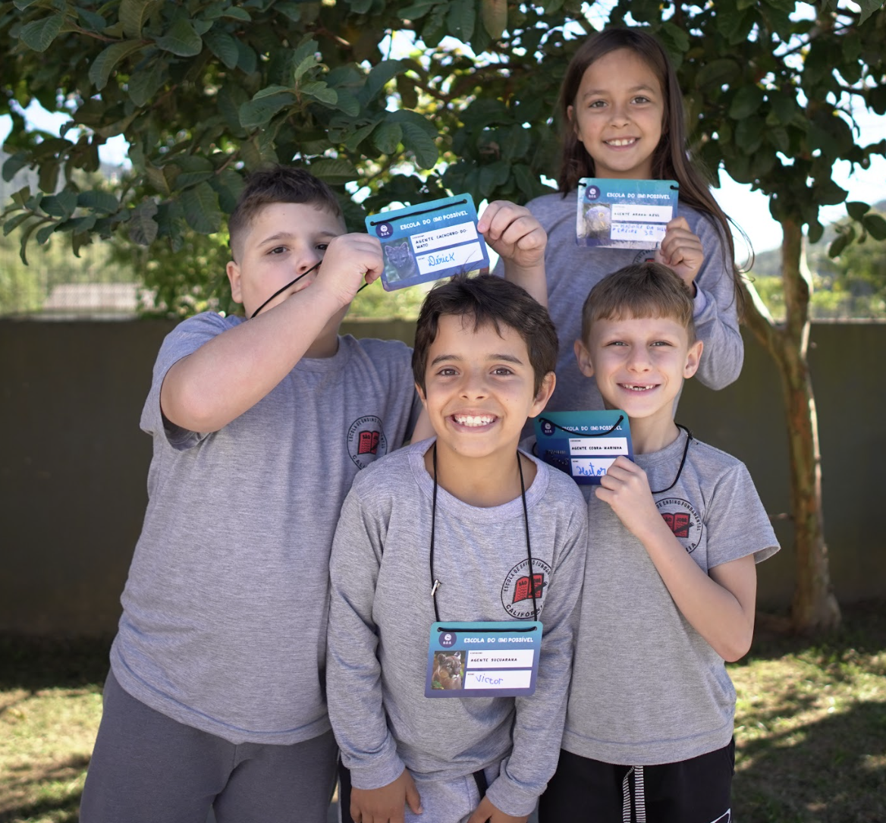

Slide 13
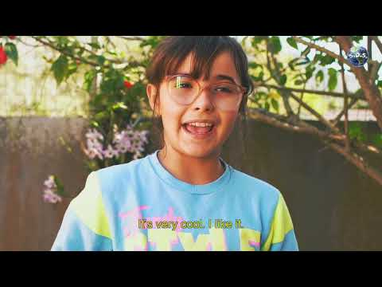

Slide 14
THE MISSIONS

Slide 15
EDUCATION
Program Structure
Objectives
Digital Resources
Curriculum Links

Slide 16
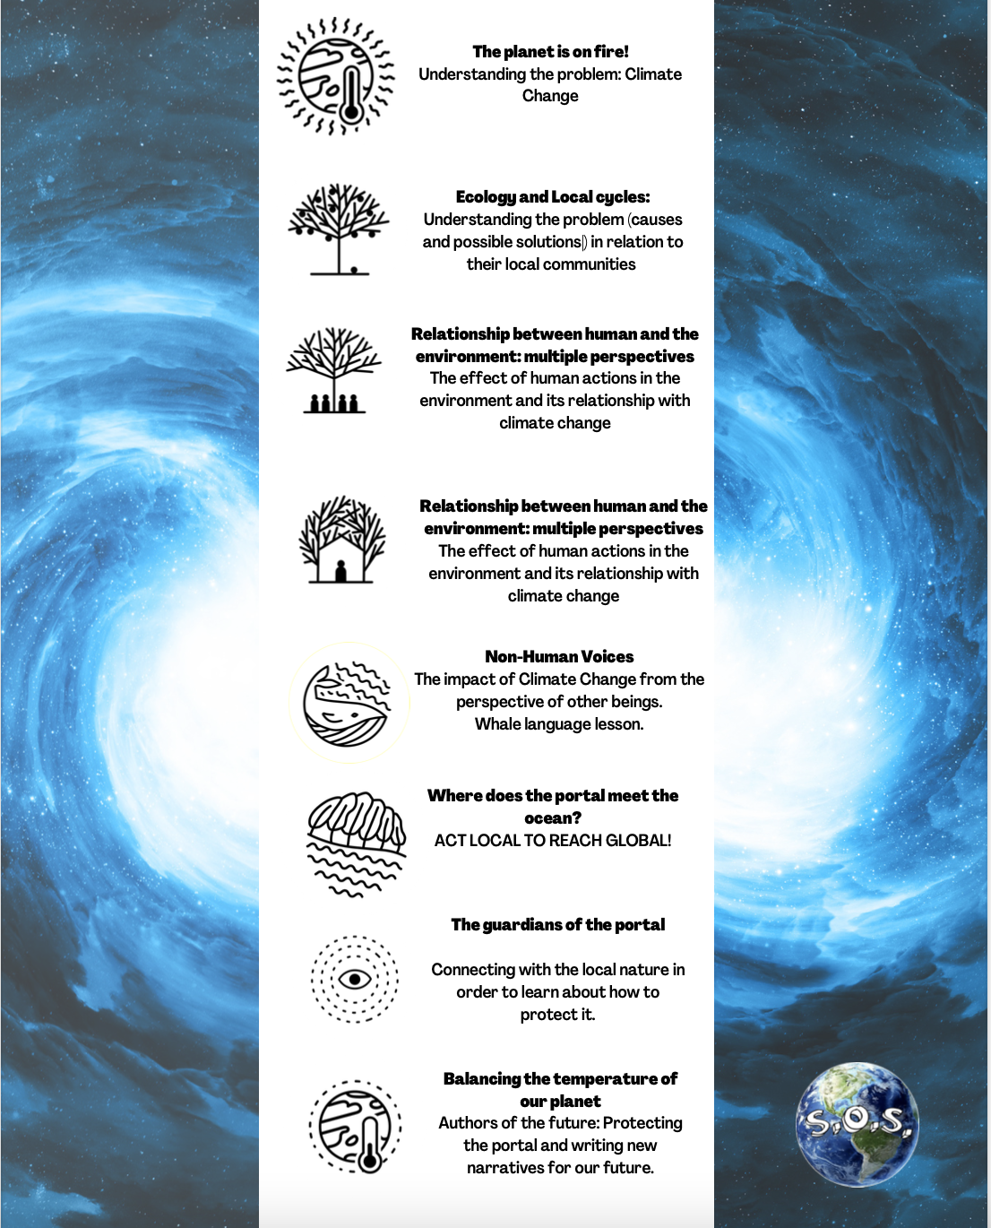

Slide 17
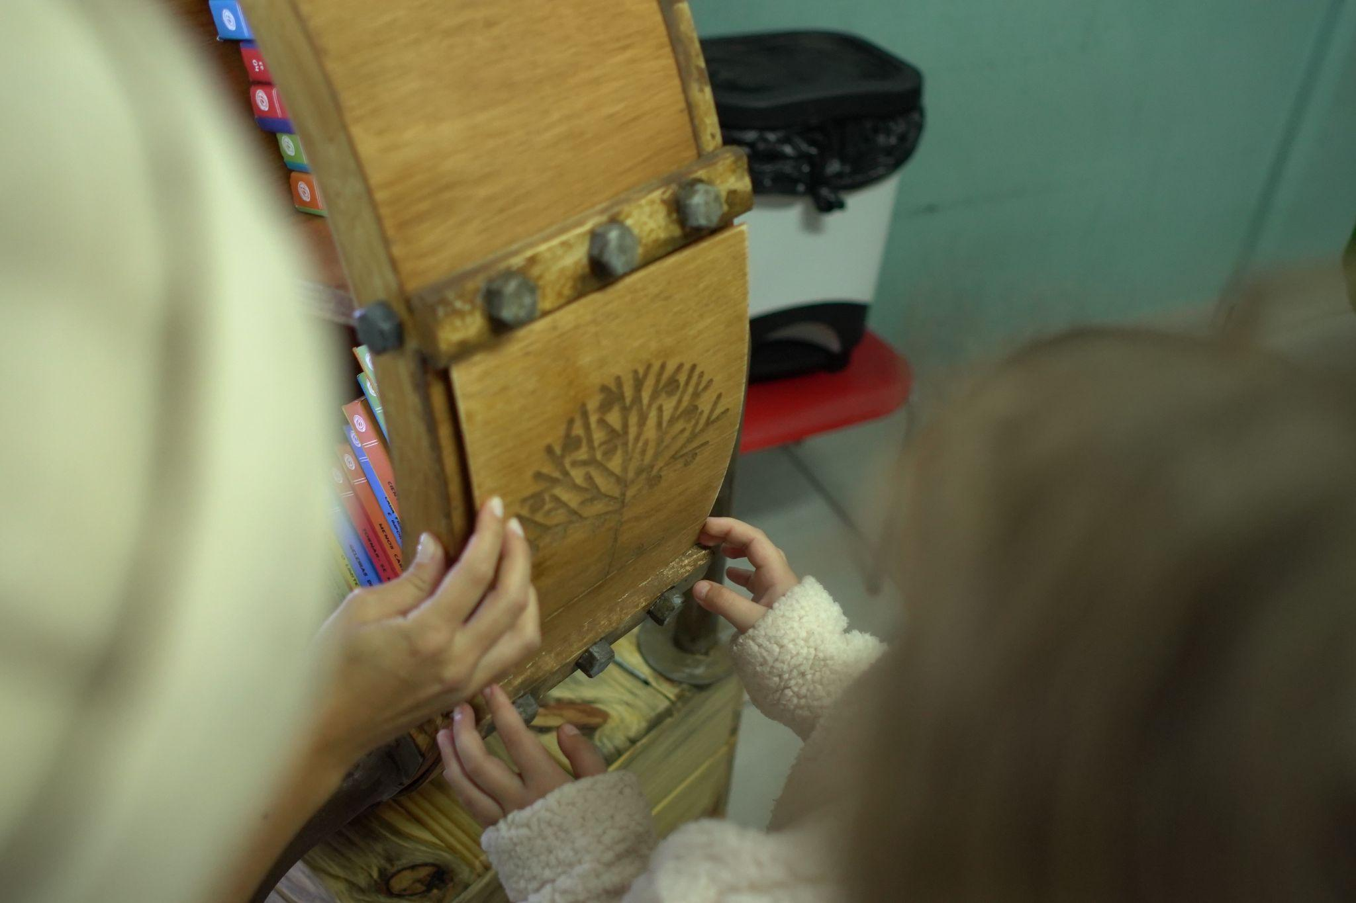
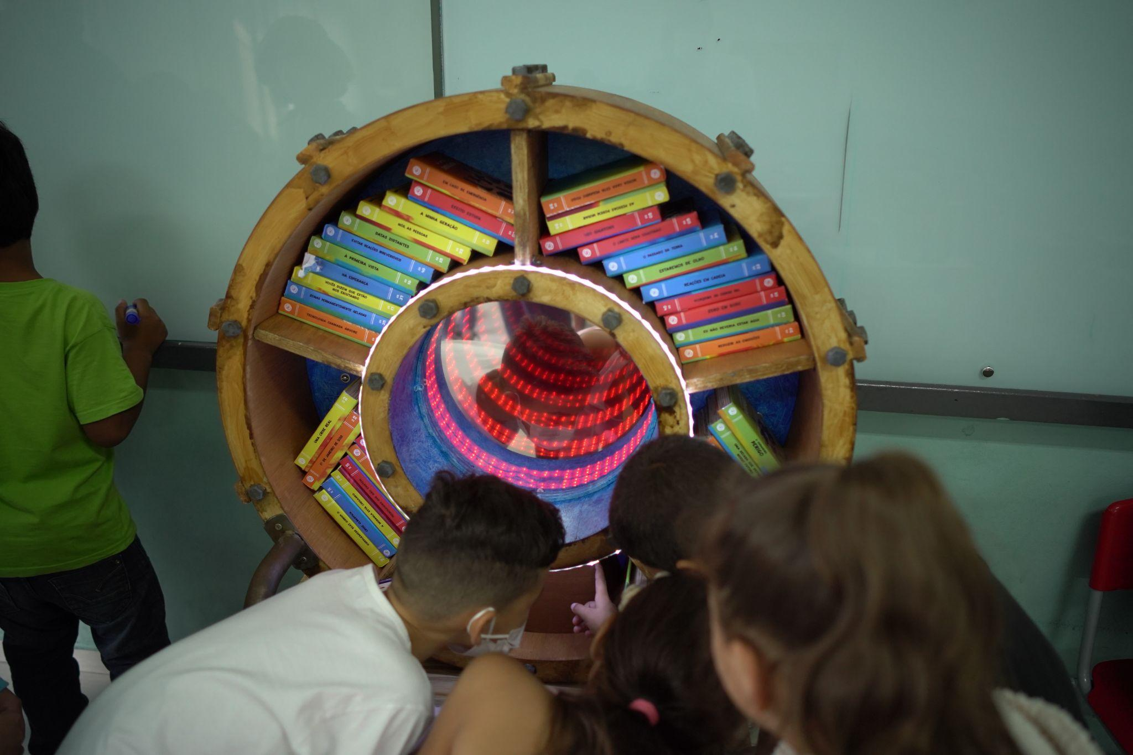
“LEARNING ADVENTURES”
ART
TECHNOLOGY
IMMERSIVE THEATRE
EDUCATION
DIGITAL
LITERACY
ACTIVE
METHODOLOGIES
+
CURRICULUM
The students are invited to see themselves as agents who transform the community while they advance in educational experiences and outcomes.

Slide 18
IMPACT
DISCOURSE
KNOWLEDGE
ACTION
CAPACITY
CONDITIONS
ATTITUDES

Slide 19
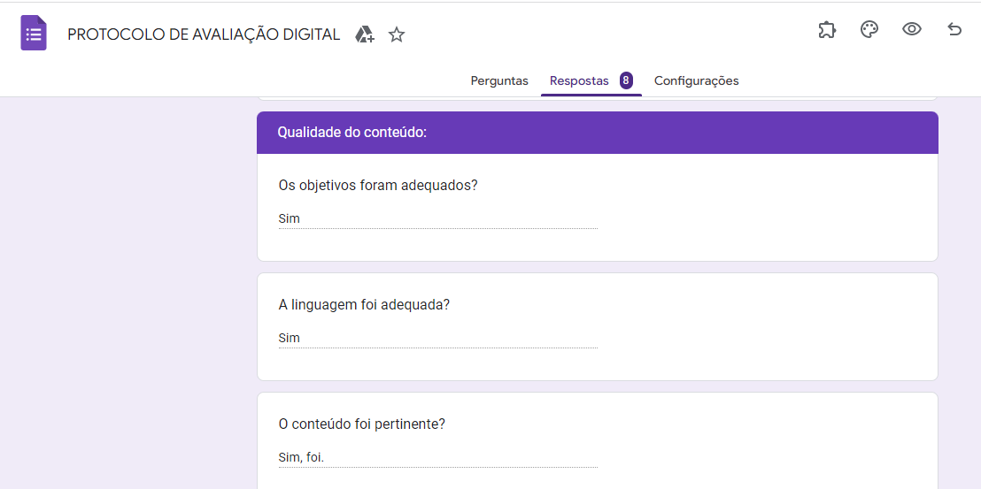
DATA COLLECTION
Image - video - audio format - feedback (written and video formats)
Teacher’s protocols
Interviews with teachers
Students’ Videos
Final event videos
Artwork created
Parent’s worksheet
Final presentation documentation
at the School of the (Im)Possible website

Slide 20
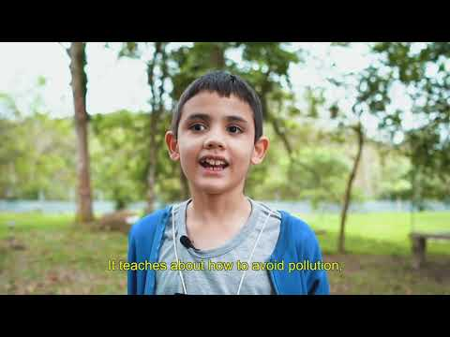

Slide 21
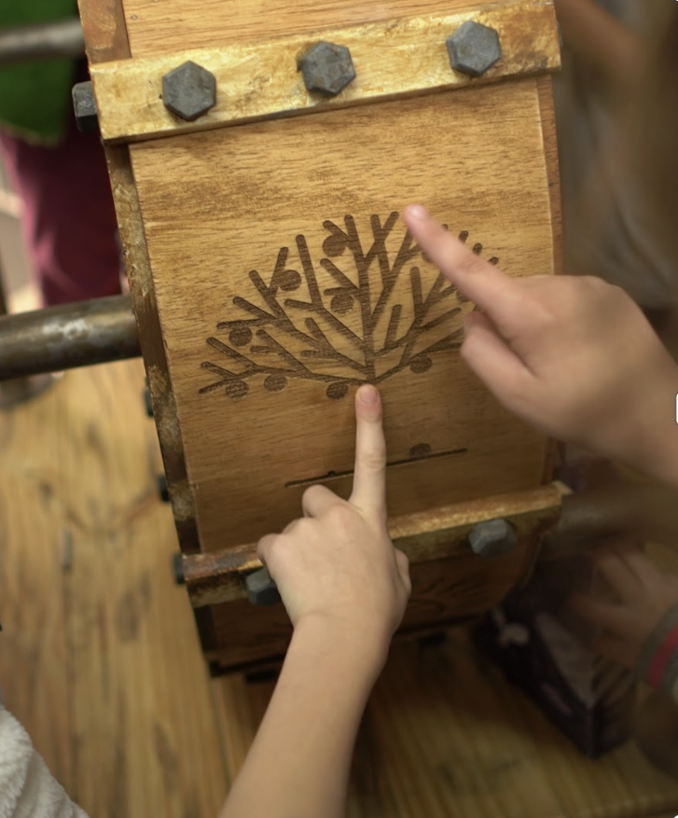
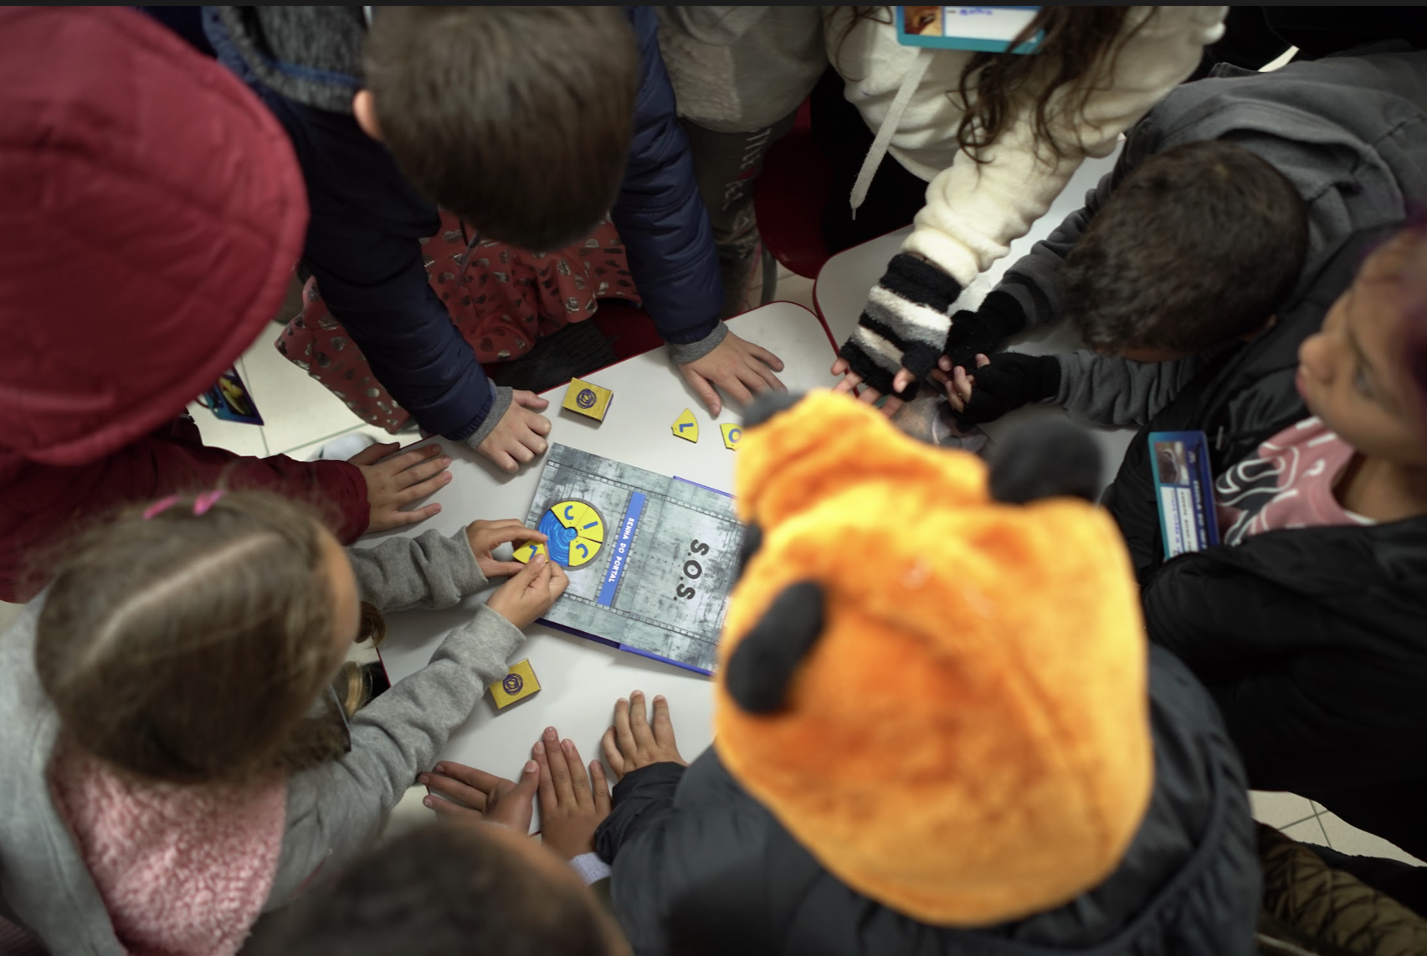
IMPACT: Changes in Knowledge
Kids increase knowledge about causes and effects of climate change, identifying its effect in their local area.

Slide 22
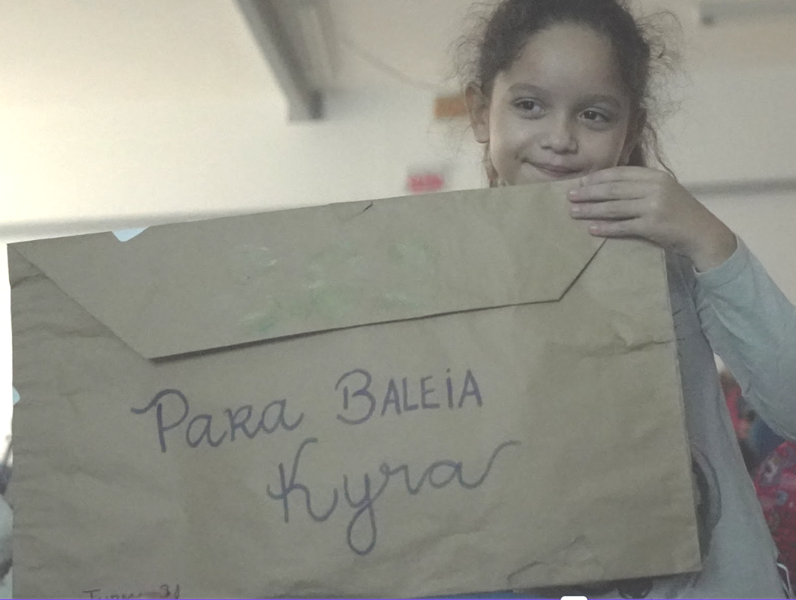
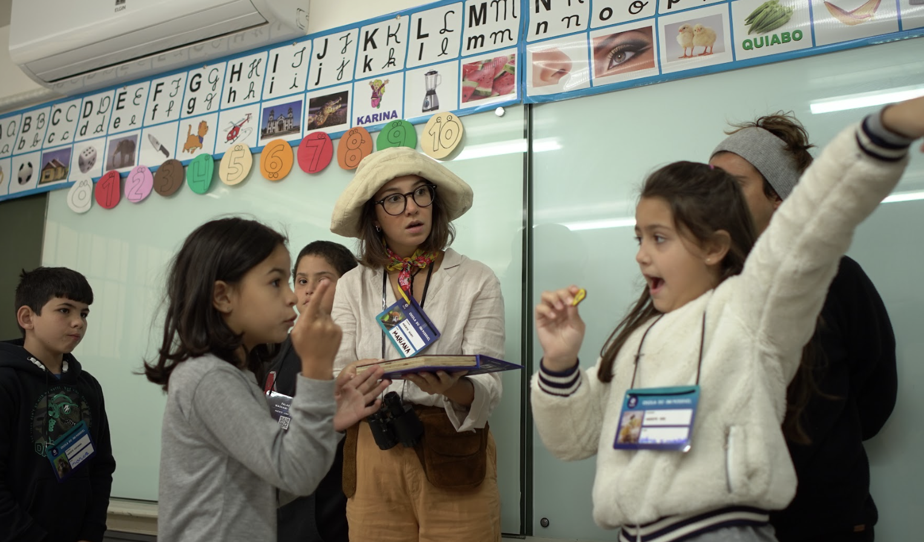
IMPACT: Changes in Knowledge
Kids gain or renew awareness about climate change

Slide 24
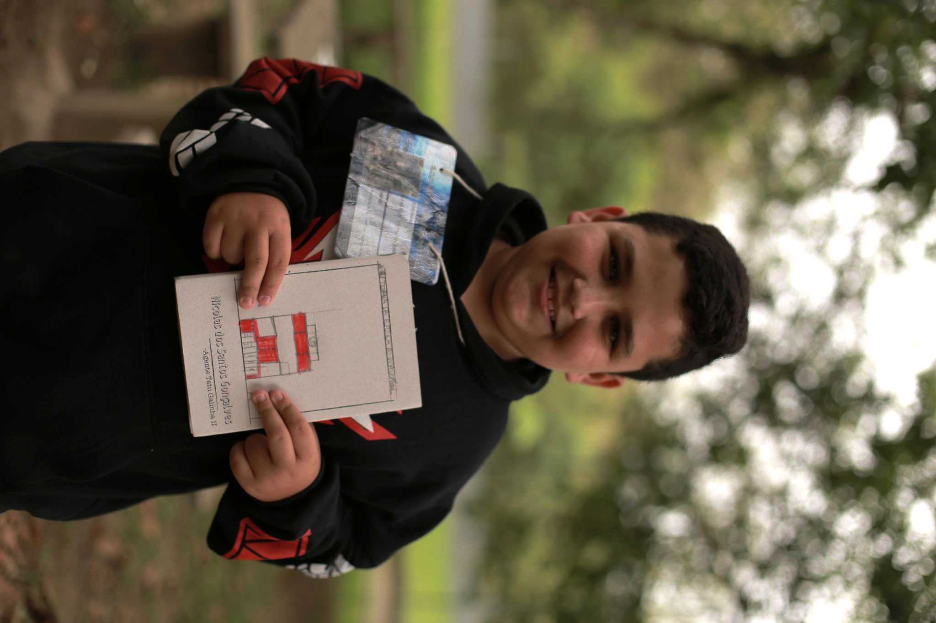
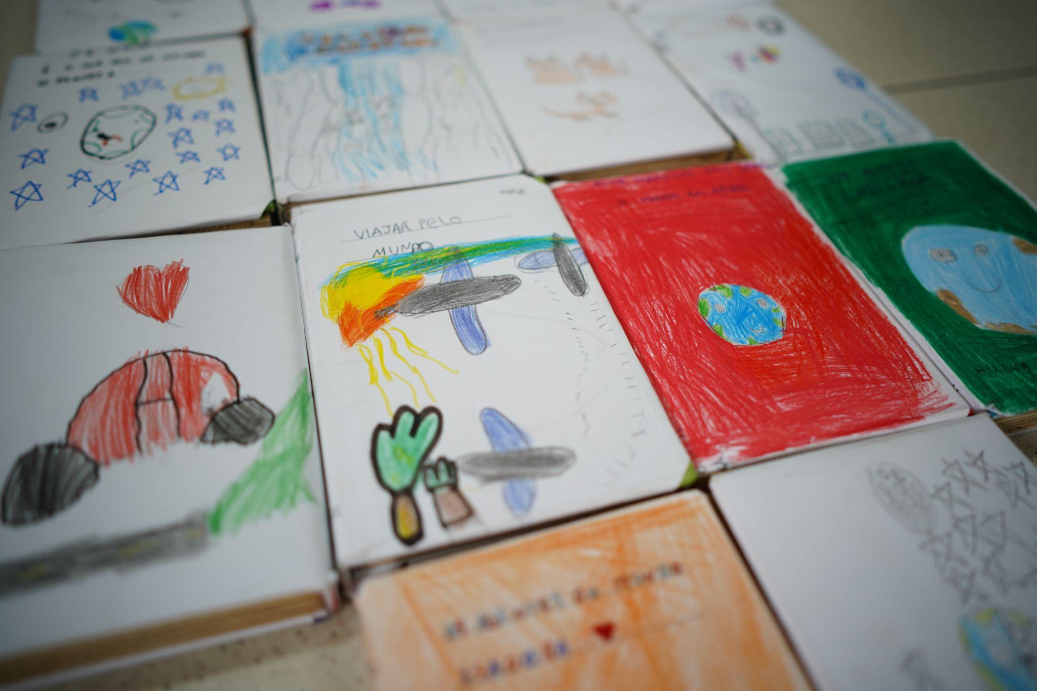
IMPACT: Changes in Discourse
The students became “the teachers”, sharing their perspectives and creating new ideas for combating climate change.

Slide 25
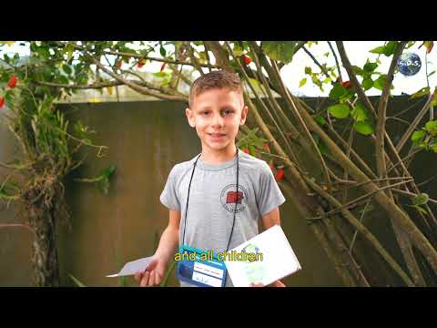
IMPACT: Changes in ATTITUDE

Slide 26
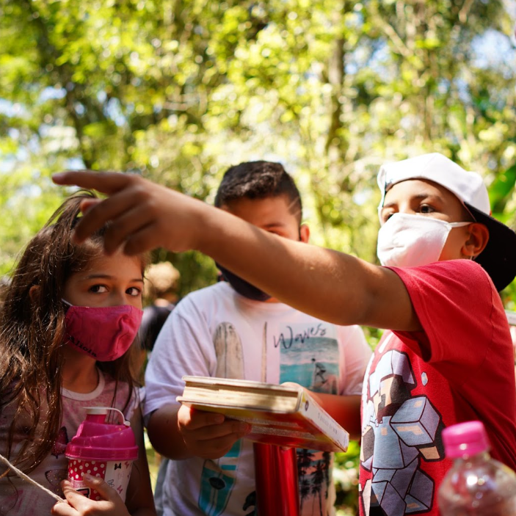
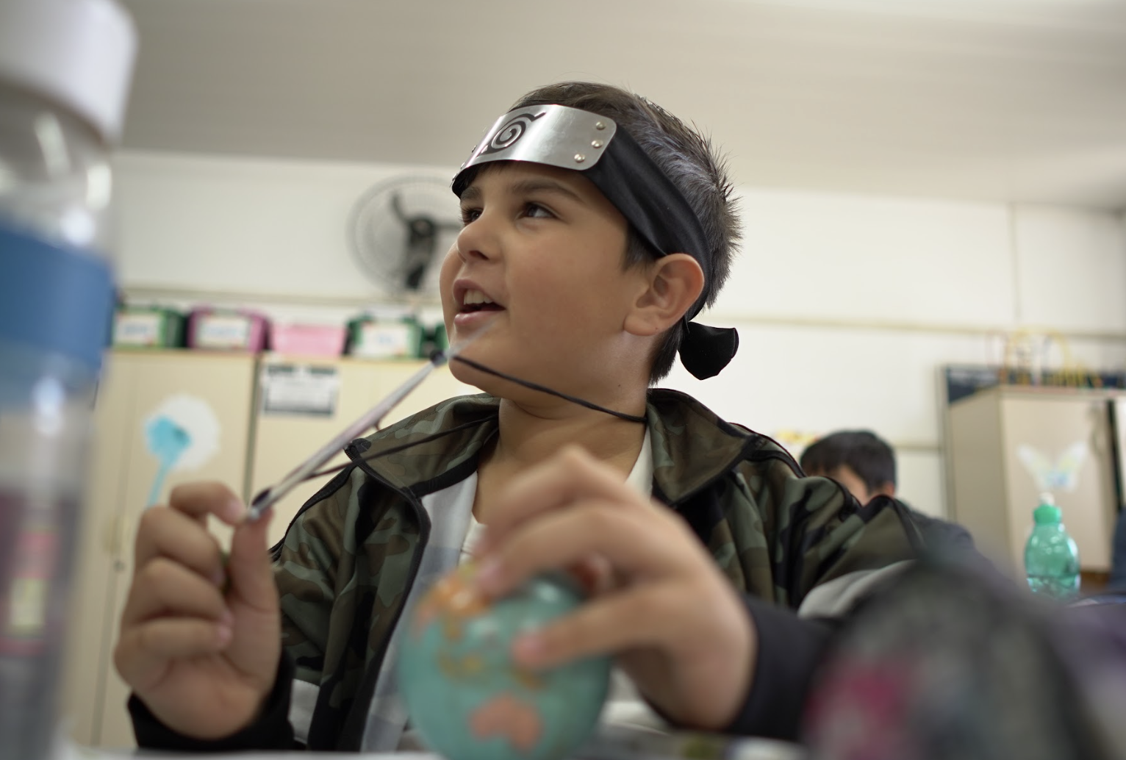
IMPACT: Changes in ATTITUDE
Kids view themselves as agents of change.

Slide 28
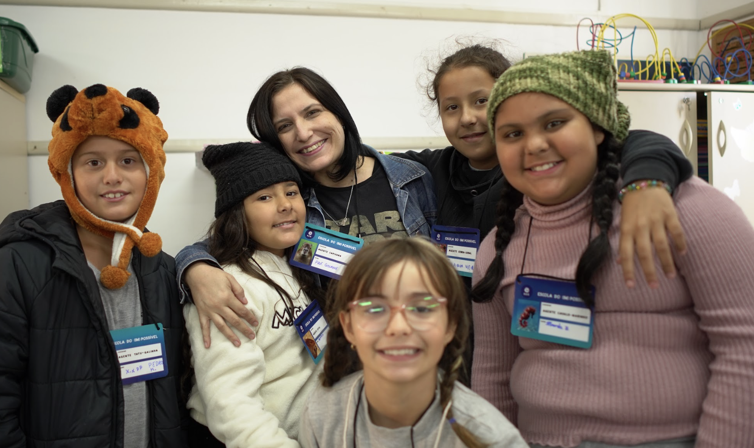
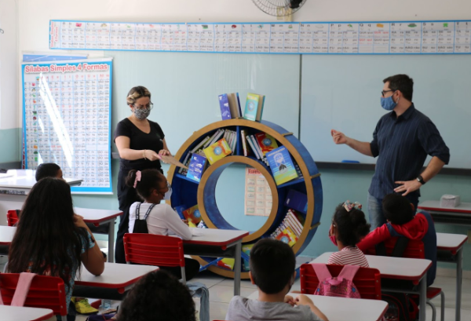
IMPACT: CAPACITY
Schools embrace the experience. They develop new capacities to integrate Art and Technology to advance youth engagement in the environmental causes.

Slide 29
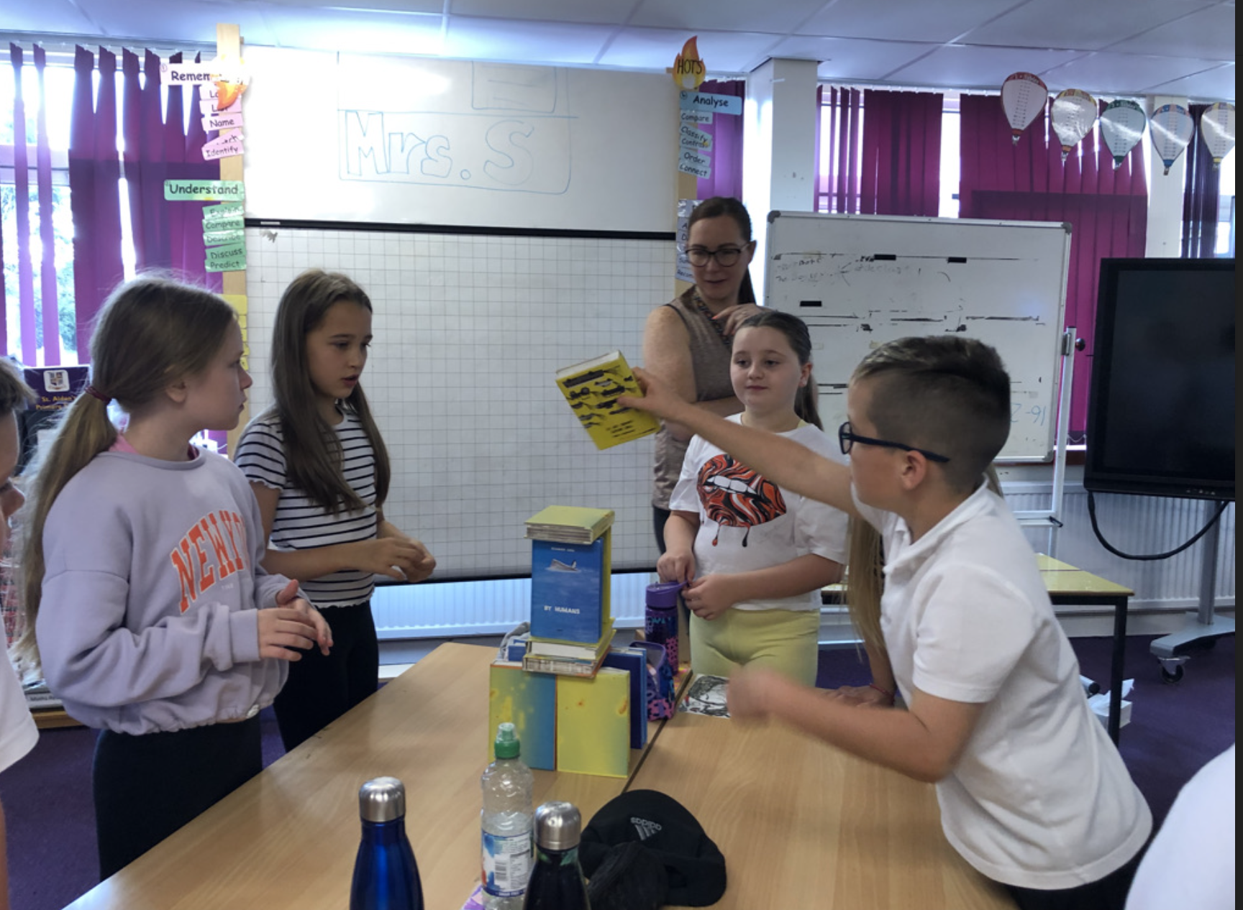
IMPACT: CONDITIONS
Schools in Brazil and Scotland integrate the project in their curriculum, providing new and innovative ways of ‘greening the curriculum’.
The project gains more effectiveness and support as an effective methodology for transforming education and teaching practice

Slide 31
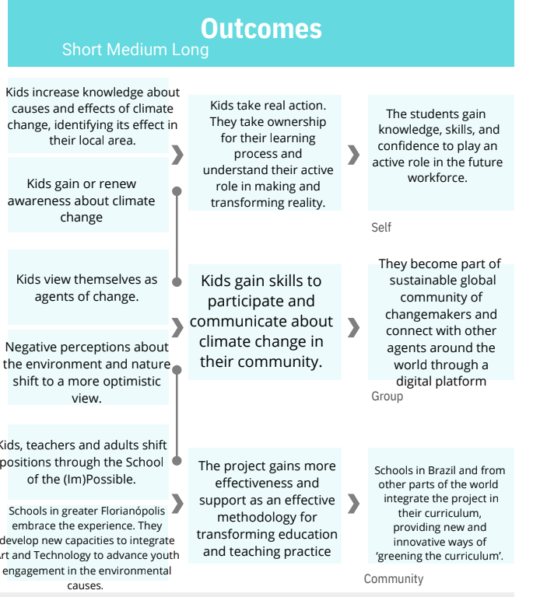

Slide 32
“Reality can be entered through the main door, or it can be slipped into through a window, which is much more fun “
Gianni Rodari

Slide 33
www.platocultural.com
www.instagram.com/platocultural
General Info: info@platocultural.com
Francine Kliemann Founder and Artistic Director - francine@platocultural.com
Marcia Donadel - Head of Learning marcia@platocultural.com

