Slide 1
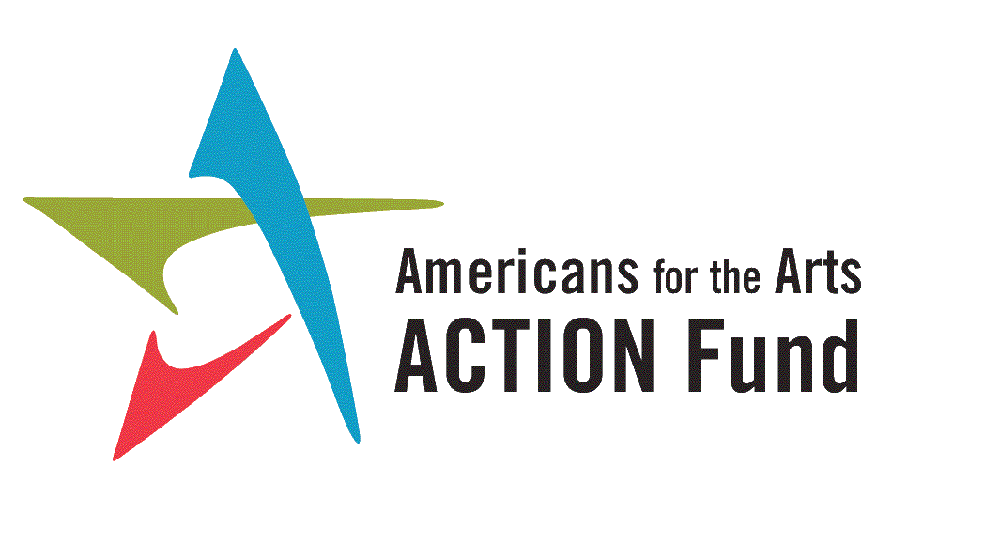
AmericansForTheArts.org
ArtsActionFund.org
@Americans4Arts
@ArtsActionFund
Notes:
Delete David Reid
Add Tom DeCaigny
Local person
State Person

Slide 2
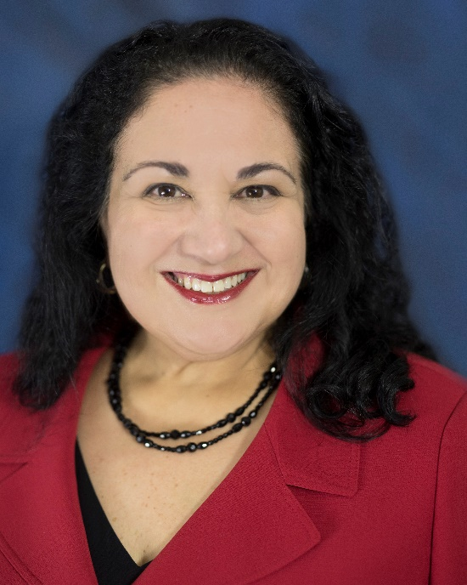
Nina Ozlu Tunceli Chief Counsel of Govt & Public Affairs, Americans for the Arts
Executive Director, Americans for the Arts Action Fund
AmericansForTheArts.org
ArtsActionFund.org
@Americans4Arts
@ArtsActionFund

Slide 3
Post-Election Impact on the Arts Webinar Agenda & Speakers
An Overview of Election Outcomes
Nina Ozlu Tunceli, Chief Counsel, Americans for the Arts & Exec. Director, Arts Action Fund
Advocacy Opportunities in a Climate of Change
Nolen V. Bivens, President & CEO of Americans for the Arts
Congressional Federal Changes and Impact on the Arts with Q&A
Tooshar Swain, Director of Public Policy, Americans for the Arts
Jeremy V. Johnson, President & CEO, Assembly for the Arts, Cleveland, OH
Tera Proby, Advocacy Manager, Americans for the Arts
State and Local Changes and Impact on the Arts with Q&A
Jay Dick, Senior Director of State & Local Government Affairs, Americans for the Arts
Tom DeCaigny, Executive Director, Create CA, Pasadena, CA
Patrick McWhortor, CEO, Arizona Citizens for the Arts, Phoenix, AZ
Josh Reynolds, Government Affairs Coordinator, Americans for the Arts
Congressional Remarks
Representative Suzanne Bonamici (D-OR-1), Chair, Congressional STEAM Caucus
AmericansForTheArts.org
ArtsActionFund.org
@Americans4Arts
@ArtsActionFund

Slide 4
Topline Federal Election Takeaways
Changes in Party Control
Changes in Party Leadership
Lame Duck Session until Dec 21st.
118th Congress swearing-in on January 3, 2023
Raising the Debt Ceiling
Prospective Agenda and Arts Bills to be Reintroduced
AmericansForTheArts.org
ArtsActionFund.org
@Americans4Arts
@ArtsActionFund

Slide 5
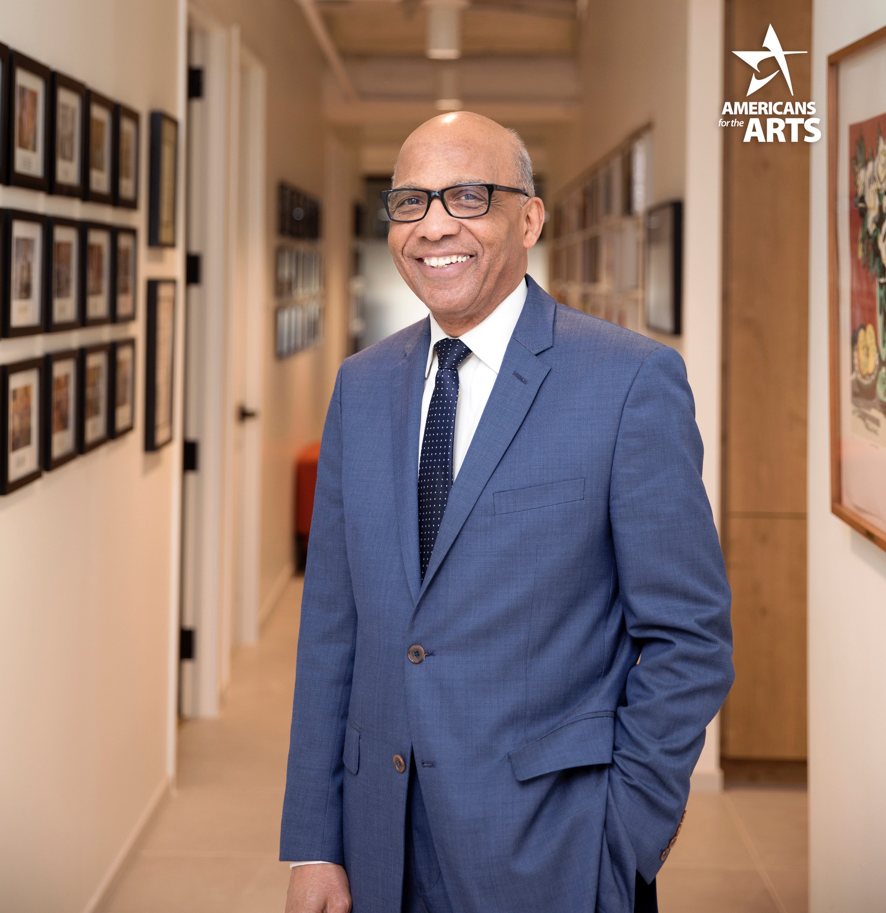
Nolen V. Bivens President & CEO, Americans for the Arts
AmericansForTheArts.org
ArtsActionFund.org
@Americans4Arts
@ArtsActionFund
Notes:
Center Equity in everything we do
Change yields opportunities
What we do is as important as how we do it
Advocacy focusing on the local level going up to the federal level
All politics is local

Slide 6
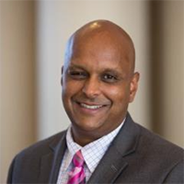
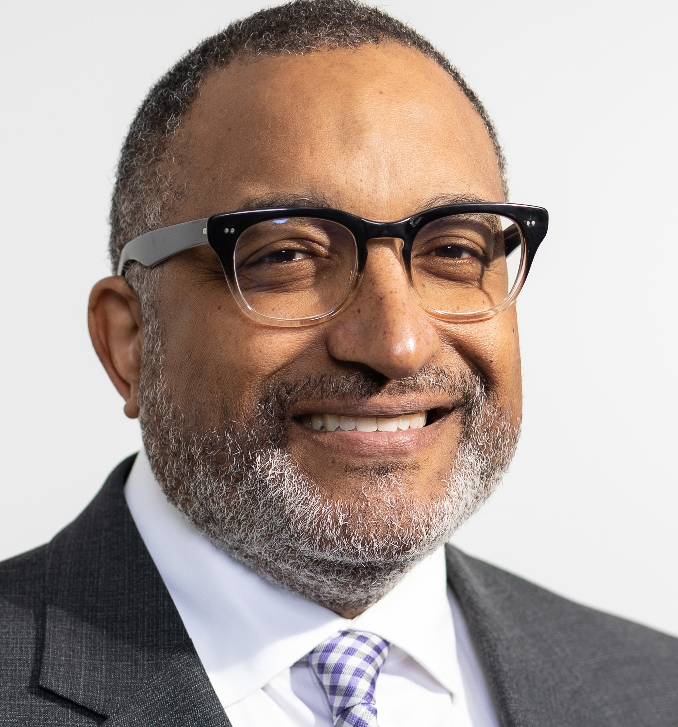
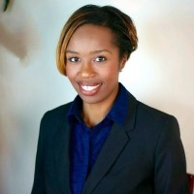
Tera Proby Advocacy Manager,
Americans for the Arts
Tooshar Swain Director of Public Policy, Americans for the Arts
Jeremy V. Johnson President & CEO,
Assembly for the Arts
Cleveland, OH
AmericansForTheArts.org
ArtsActionFund.org
@Americans4Arts
@ArtsActionFund

Slide 7
House: Quick Numbers
Incoming 118th Congress (2022-2023)
212 Democrats – 218 Republicans
365 House districts in which an incumbent faced re-election, only 6 Ds and 3 Rs lost their seats
74 House Freshmen (41 GOP, 33 Democrats)
Notable Firsts:
Becca Balint (D-VT)- First female and openly LGBTQ Rep. from Vermont
Katie Britt (R-AL)- First female Senator from Alabama
Summer Lee (D-PA)- First Black female Rep. from Pennsylvania
Delia Ramirez (D-IL)- First Latina from Illinois
Markwayne Mullin (R-OK)- First Native American Senator from Oklahoma
Maxwell Frost (D-FL)- First Gen Z member of Congress
AmericansForTheArts.org
ArtsActionFund.org
@Americans4Arts
@ArtsActionFund

Slide 8
Congressional Arts & STEAM Caucuses
Congressional Arts Caucus:
Losing 21 Democrats (election losses/retirements/seeking another office) and 3 Republicans (retirement/election losses).
Chellie Pingree (D-ME)will return as one co-chair.
STEAM Caucus:
Losing 7 Democrats (election losses/retirements/seeking another office) and 3 Republicans (retirements/election losses).
Co-Chair Suzanne Bonamici (D-OR) will be returning.
AmericansForTheArts.org
ArtsActionFund.org
@Americans4Arts
@ArtsActionFund

Slide 9
Committee Leadership Changes
House Interior Appropriations Subcommittee
David Joyce (R-OH) new Chairman and Ranking Member Chellie Pingree (D-ME)
Labor-HHS-Education Appropriations Subcommittee
Tom Cole (R-OK) new Chairman and Ranking Member Rosa DeLauro (D-CT).
Ways and Means
Jason Smith (R-MO), Adrian Smith (R-NE) and Vern Buchanan (R-FL) vying for leadership with Ranking Member Richard Neal (D-MA)
Education Labor
Rep. Virginia Foxx and Ranking Rep. Bobby Scott (D-VA)
Small Business
Rep. Blaine Lutekeymeyer (R-MO) new Chairman and Ranking Member Nydia Velazquez (D-NY)
AmericansForTheArts.org
ArtsActionFund.org
@Americans4Arts
@ArtsActionFund
Notes:
Changes happening in approps (full and subcommittees)
Not sure yet if other changes will happen

Slide 10
Senate Outlook
Democrats 50 Republicans 49
Currently, Dems flipped 1 seat, the GOP flipped no seats, and the GA seat is headed for a runoff election on Dec 6.
Georgia Matters!
Ability to confirm appointees
Quicker advancement of bills
Buffer Vote
AmericansForTheArts.org
ArtsActionFund.org
@Americans4Arts
@ArtsActionFund
Notes:
5 retiring and 3 defeated Senate members = 8 departures
7 senators running for president?

Slide 11
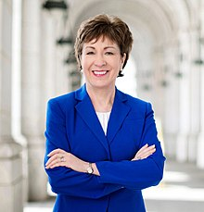
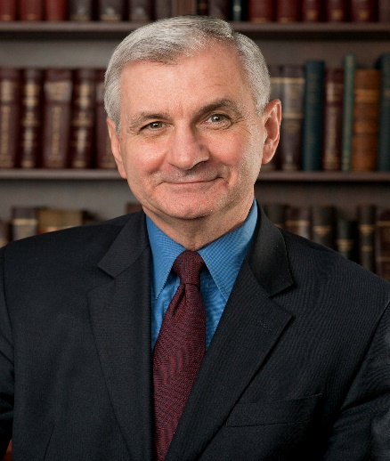
Senate Cultural Caucus
No losses and Sen. Susan Collins (R-ME) and Sen. Jack Reed (D-RI) will remain as Co-Chairs
AmericansForTheArts.org
ArtsActionFund.org
@Americans4Arts
@ArtsActionFund

Slide 12
Senate Cultural Caucus
36 Members as of 11/21/22
Lisa Murkowski AK
Dan Sullivan AK
Dianne Feinstein CA
Alex Padilla CA
Michael Bennet CO
Richard Blumenthal CT
Chris Murphy CT
Chris Coons DE
Mazie Hirono HI
Brian Schatz HI
Richard Durbin IL
Ed Markey MA
Chris Van Hollen MD
Susan Collins ME
Angus King, Jr. ME
Debbie Stabenow MI
Gary Peters MI
Amy Klobuchar MN
Roger Wicker MS
Jon Tester MT
John Hoeven ND
Maggie Hassan NH
Jeanne Shaheen NH
Robert Menendez NJ
Cory Booker NJ
Martin Heinrich NM
Charles Schumer NY
Kristen Gillibrand NY
Sherrod Brown OH
Jeff Merkley OR
Jack Reed RI
Sheldon Whitehouse RI
Maria Cantwell WA
Patty Murray WA
Joe Manchin WV
Shelley Moore Capito WV
AmericansForTheArts.org
ArtsActionFund.org
@Americans4Arts
@ArtsActionFund

Slide 13
Committee Leadership Changes
Senate Appropriations Committee
Patty Murray (D-WA) new Chairwoman and Ranking Member Susan Collins (R-ME)
Senate HELP Committee
Bernie Sanders (I-VT) new Chairman and Rand Paul (R-KY)?
AmericansForTheArts.org
ArtsActionFund.org
@Americans4Arts
@ArtsActionFund
Notes:
Changes happening in approps (full and subcommittees)
Not sure yet if other changes will happen

Slide 14
Lame Duck Session – Appropriations
Appropriations
Deadline to fund the government is December 16. Election results increase likelihood that FY23 funding will be completed by end of year.
Funding for the Arts:
NEA-NEH Funding where arts advocates support $207 million passed by the House, but the Senate level proposed only $195 million.
$207 million a step toward $1 per capita.
AmericansForTheArts.org
ArtsActionFund.org
@Americans4Arts
@ArtsActionFund

Slide 15
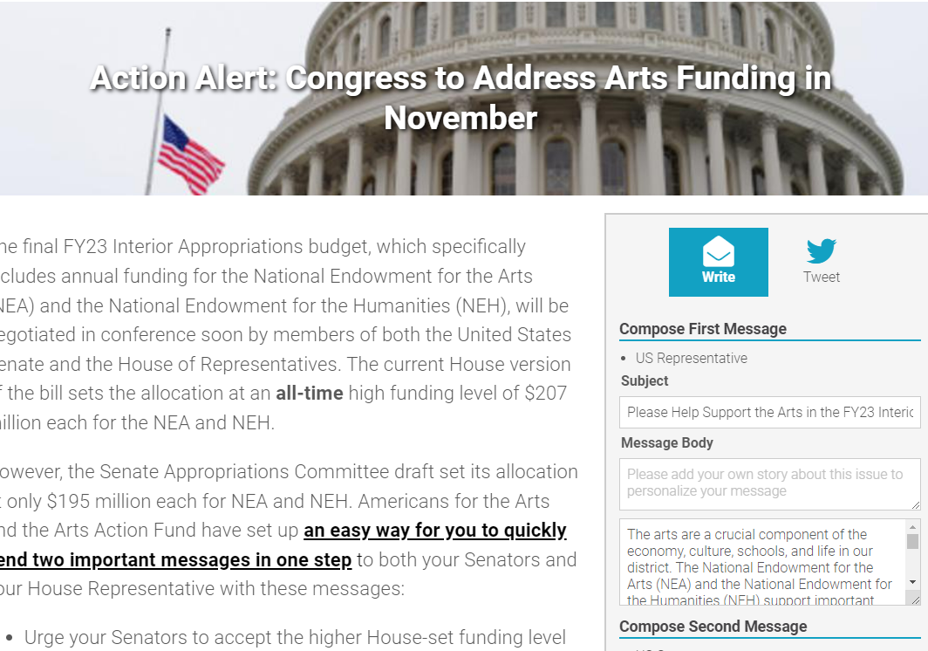
Act Now On NEA-NEH Funding!
Contact your member of Congress today
AmericansForTheArts.org
ArtsActionFund.org
@Americans4Arts
@ArtsActionFund

Slide 16
Lame Duck Session – Tax Bill
Democrats and Republicans trying to coalesce around R&D and tax credit extensions. Legislation would have narrow focus but several items in play:
Performing Artists Parity in Tax Act (PATPA)
Universal Charitable Deduction
Employee Retention Tax Credit Reinstatement
Legacy IRA Act
AmericansForTheArts.org
ArtsActionFund.org
@Americans4Arts
@ArtsActionFund

Slide 17
Diversity, Equity and Inclusion (DEI) Goals
Monitor and create legislation that advances DEI in the arts and arts education
Working to advance existing DEI efforts within federal agencies, such as the NEA
Worked with arts advocates to advance DEI efforts on the state level
Creating pipeline opportunities for diverse communities
AmericansForTheArts.org
ArtsActionFund.org
@Americans4Arts
@ArtsActionFund

Slide 18
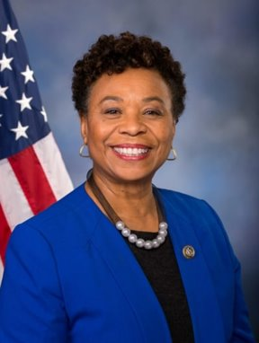
Advancing Equity though the Arts and Humanities Act of 2022 –H.R. 7627
Introduced by Congresswoman Barbara Lee (CA-13) April 28, 2022
Works to address inequity in the arts and humanities by providing NEA funding to Black, Indigenous, and People-of-Color (BIPOC) led organizations.
Requires Bi-Partisan support to advance the legislation.
Advocates should continue to develop relationships with Democrat and Republican Members in their Congressional delegation.
AmericansForTheArts.org
ArtsActionFund.org
@Americans4Arts
@ArtsActionFund

Slide 19
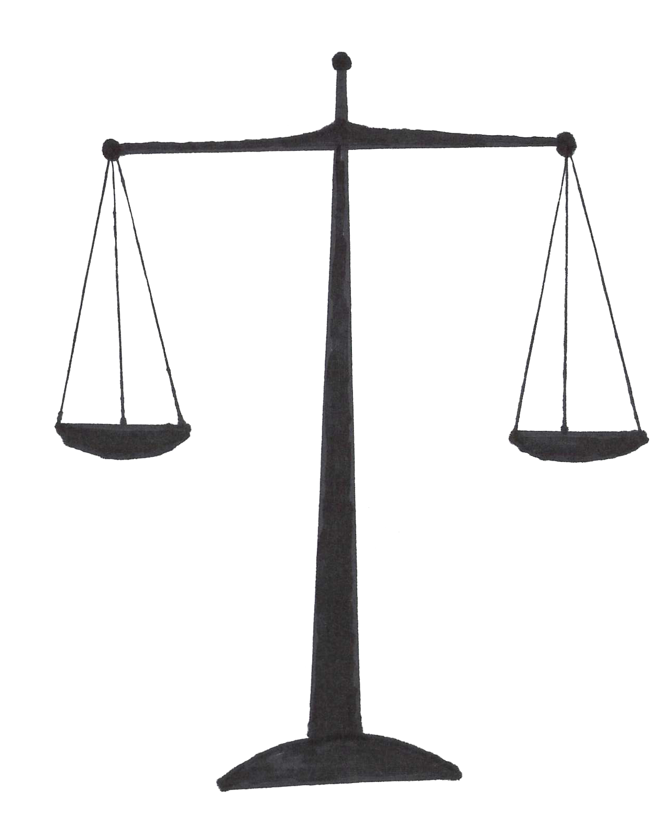
Arts in Juvenile Justice
Arts and Juvenile Justice Working Group
Meetings with the U.S. Department of Justice
Title V Delinquency Prevention Grants in legislative appropriations
Bipartisan advocacy is essential
This Photo by Unknown author is licensed under CC BY-SA.
AmericansForTheArts.org
ArtsActionFund.org
@Americans4Arts
@ArtsActionFund
Notes:
Currently, still 8 outstanding House races to be called
Democrats retained their majority in the House, although, it will be much smaller in the 117th Congress
It was not the “Blue Wave” many pundits and polls were predicting
Republicans were able to flip back many of the seats in Trump-voting districts that Democrats had turned blue in the 2018 mid-terms

Slide 20
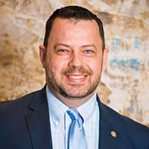
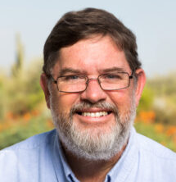
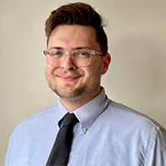
Jay Dick Senior Director of State and Local Government Affairs, Americans for the Arts
Tom DeCaigny Executive Director, Create CA
Pasadena, CA
Patrick McWhortor CEO, Arizona Citizens for the Arts
Phoenix, AZ
Josh Reynolds Government Affairs Coordinator, Americans for the Arts
AmericansForTheArts.org
ArtsActionFund.org
@Americans4Arts
@ArtsActionFund

Slide 21
State Elections
Every Four Years – Massive State Elections
Elections in 46 States (Louisiana, Mississippi, New Jersey and Virginia did not have state elections)
36 Governor/ Lt Governor Elections
88 of the country’s 99 state legislative chambers up for election
6,278 state legislators out of 7,383 or 85%
2022 State Election Top Line Statement:
“Democrats Make Gains, Republicans Remain Dominant”
AmericansForTheArts.org
ArtsActionFund.org
@Americans4Arts
@ArtsActionFund
Notes:
Every four years there is a major election in the states and 2022 was that year! 36 governors up for election 88 of 99 state legislative chambers in 46 states. 6,278 state legislators out of 7383 85% of all state legislators
With all the focus on a tidal wave, state elections netting very little change.

Slide 22
AmericansForTheArts.org
ArtsActionFund.org
@Americans4Arts
@ArtsActionFund
Notes:
As i stated gubernatorial elections were held in 36 states and 3 territories, with 31 incumbent Governors eligible to run for re-election and eight Governors not eligible or not seeking reelection.
Pre election Dem 22 Republicans 28
So Dems picked up 2 and Republicans lost 2 Assuming Alaska Gov stays in Republican hands with Gov. Mike Dunleavy
Republican pick up - Nevada Dem Gov Sisolak lost to Republican Joe Lombardo.
Dem picked up Arizona Katie Hobbs Maryland Wes Moore and Massachusetts Maura Healey
A 24/26 split is pretty close, closer than it has been in decades.

Slide 23
AmericansForTheArts.org
ArtsActionFund.org
@Americans4Arts
@ArtsActionFund
Notes:
In states with one party controlling both houses and the governor’s seat, we call it a Trifecta.
Before the election, Republicans had full control in 23 states, Democrats had full control in 14 states, and 13 had divided control—
The election puts Democrats at 17 (plus 3) Republicans down to 21 states (minus 2), and the number of divided states is down to 10 (minus 3). The Republicans number should go up to 22 with Alaska and Maybe 23 with NH.
Dems picked up MA, MD, MI and MN but lost NV
Rep lost AZ
Kansas and Kentucky have a Dem Gov, but Veto proof Republican Legislatures so it is almost like a trifecta.
Most divided the nation has been since the late 1800s. Red is redder, blue is bluer.

Slide 24
Interesting State Election Facts
Representation of Women in State Legislatures was flat after this election with just over 30% of all state legislators
Florida and Kentucky’s women legislators are mostly Republican
Delaware, Florida and Nebraska showed a bump in women legislators
12 women (8D, 4R) will serve as governors in 2023, marking a new record (previous record: 9, first set in 2004). They will be 24% of all governors in the U.S.
AmericansForTheArts.org
ArtsActionFund.org
@Americans4Arts
@ArtsActionFund

Slide 25
Interesting State Election Facts
Women will for the first time serve simultaneously as governor and lieutenant governor in two states: Arkansas and Massachusetts Maryland
Maryland Governor-Elect Wes Moore becomes only the third black governor ever in the US
The Maryland Governor, Lt. Governor, Attorney General and Comptroller are all people of color, a first for any state.
Hundreds of new legislators in general
AmericansForTheArts.org
ArtsActionFund.org
@Americans4Arts
@ArtsActionFund
Notes:
Moore joins only Douglas Wilder of Virginia and Deval Patrick of Mass as the only Black governors elected in this nation’s 246-year history.
Across the nation, 36 states held gubernatorial elections but only a handful of them featured Black nominees: Stacey Abrams in Georgia, Deidre DeJear in Iowa, Yolanda Flowers in Alabama, Chris Jones in Arkansas, and Moore — all Democrats.
All but Moore fell short in their bids.

Slide 26
Take-A-Ways
Half of State Legislatures will have veto-proof majorities
Essential for the Arts to remain BipARTisan and work with the party in power.
17 Republican States (Added: FL and OH)
9 Democratic States (Added: VT, DE and IL)
New Opportunities to build relationships around the Arts
At least 32 new Chamber Leaders
9 new Governors and 16 new Lt. Governors
Multiple new Committee Chairs
Opportunity for the Arts to influence legislative agendas with new leadership
AmericansForTheArts.org
ArtsActionFund.org
@Americans4Arts
@ArtsActionFund
Notes:
Opportunity given new leaders!!!
up from 21 states, have veto proof - some super duper majorities HI, MA,
Many new New Committee chairs
16 new Lt. Governors
9 new Governors

Slide 27
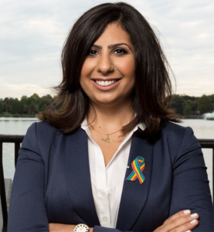
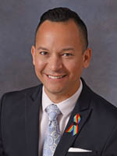
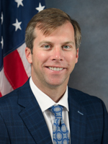
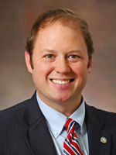
Florida BipARTisian Arts Support
Never assume someone is a supporter or opposition based on party.
Florida appropriated a record $59,088,125 to fund 710 Florida cultural programs and projects.
Is the highest dollar amount serving the most grantees in the history of the State of Florida.
AmericansForTheArts.org
ArtsActionFund.org
@Americans4Arts
@ArtsActionFund
Notes:
2022 Public Leadership in the Arts Award Winners - to be presented at NCSL Winter meeting Dec 6,7
Florida Representatives Anna Eskamani, Carlos Guillermo Smith, Jay Trumbull and Jayer Williamson Two Democrats and Two Republicans

Slide 28
Take-A-Ways
State budgets for 2023 are estimated to be increasing by 4.2%. This is down from 13.6% in 2022 when states were spending ARPA funds.
Governors have collectively called for approximately $15 billion in tax cuts (both blue and red states)
Historic appropriations for State Arts Agencies could be in danger of decreases.
Advocates need to educate new legislators about the economic impact of the arts to protect funding.
AmericansForTheArts.org
ArtsActionFund.org
@Americans4Arts
@ArtsActionFund
Notes:
2022 Public Leadership in the Arts Award Winners - to be presented at NCSL Winter meeting Dec 6,7
Florida Representatives Anna Eskamani, Carlos Guillermo Smith, Jay Trumbull and Jayer Williamson Two Democrats and Two Republicans
States have record rainy day funds - another economic lever for funding - but very hard to get state’s to use.

Slide 29
State Trends Affecting the Arts
Budgets - ARPA funds will start to run out
Tax Cuts - Proposals of $15 billion
Infrastructure - Spurred on by ARPA funds
Mental Health - Medicaid spending slow down to 0.8% (from 10.6%) - less money for other programs but potential focus on Arts for mental health care
Workforce Development - Job Training
Education - Arts in Education Initiatives
Civil Justice - Using the arts to promote equitable reforms
AmericansForTheArts.org
ArtsActionFund.org
@Americans4Arts
@ArtsActionFund
Notes:
Governors’ budgets for fiscal 2023 call for a 4.2 percent increase in general fund spending. This follows fiscal 2022, when states are estimating spending growth of 13.6 percent, the highest annual increase in more than 40 years.
Governors proposed net tax cuts that would reduce revenue in fiscal 2023 by an estimated $15 billion for all state funds, including a $14.1 billion reduction in general fund revenue
Medicaid spending growth is expected to slow considerably as states plan for the end of the enhanced federal matching rate, with total Medicaid spending projected to increase 0.8 percent on a median basis in fiscal 2023 after growth of 10.6 percent in fiscal 2022.

Slide 30
State Leaders Priorities
Mental Health Access
Affordable Housing
Workforce Development (states lack workers)
Fentanyl drug Issue
Inflation (tax cuts)
Broadband access
Medicaid Expansion
AmericansForTheArts.org
ArtsActionFund.org
@Americans4Arts
@ArtsActionFund
Notes:
Recently at an event with a panel of bipartisian legislative leaders.
They were asked what their priorities were.
While the “arts” are unfortunately not on the list, there are some topics which we overlap with . Health care, Workforce development,

Slide 31
State Leaders Third Rail Issues
Tightening Abortion Regulations (Rep)
Expanding Gun Rights (Rep)
Raising Taxes (Dem & Rep)
Sports Betting (Dem)
Data Privacy (Dem & Rep)
Climate Change (Dem)
AmericansForTheArts.org
ArtsActionFund.org
@Americans4Arts
@ArtsActionFund
Notes:
Interesting to note what legislative leaders DON’T want to talk about.

Slide 32
State Ballot Initiatives
136 measures on state ballots this year
Average is around 172
Two types of ballot measures – Legislative & Citizen
39 Citizen Initiatives were on the ballot, a decrease from 60 in 2018 and 72 in 2016
Two Thirds of ballot initiatives passed in 2022
As most Ballot Initiatives are sponsored by the state legislature, consider advocating for future arts initiatives
AmericansForTheArts.org
ArtsActionFund.org
@Americans4Arts
@ArtsActionFund
Notes:
Legislative ballots numbers about the same
Citizens down

Slide 33
AmericansForTheArts.org
ArtsActionFund.org
@Americans4Arts
@ArtsActionFund
Notes:
All states can put measures on the ballot
In the grey states, only the legislature can do it.
Orange states, like California, citizens can initiate and force a question on the ballot. The State Legislatures can also directly put a question to the ballor
In NM and MD only the citizens can put an item on the ballot.

Slide 34
Popular State Ballot Initiative Topics
Equitable Advocacy Opportunities
Abortion (passed) (failed)
Pro-Choice California Michigan Vermont
Anti-Abortion Kansas Kentucky Montana
Tobacco, Marijuana and other drugs
Recreational Marijuana: AK MD MO ND SD
Psilocybin (magic mushrooms): Colorado
Outlaw Flavored Tobacco: California
Civil and Criminal Justice Reform
7 total, 6 passed: Slavery LA, OR TN VT Bail AL OH
AmericansForTheArts.org
ArtsActionFund.org
@Americans4Arts
@ArtsActionFund
Notes:
Voters in five states were split on recreational marijuana this year: Maryland and Missouri said yes; Arkansas, North Dakota and South Dakota said no.
In a close and uncalled race, Coloradans weighed in on an initiative to decriminalize certain psychedelic plants such as psilocybin; the first statewide measure on psilocybin passed in Oregon in 2020. Voters in the Centennial State also saw three initiatives relating to alcohol. They rejected an increase in liquor store licenses and authorization for alcohol delivery services, while the other measure on grocery store wine sales is too close to call. And Californians upheld a popular referendum banning the sale of flavored tobacco products.
Louisiana –Remove Involuntary Servitude as Punishment for a Crime from Constitution 39% said yes.

Slide 35
Local Ballot or Bond Initiatives
No database to monitor local initiatives
Miami Beach Bond initiative "Yes 2 Arts" passed 65%
$159 million in bonds for cultural institution infrastructure improvements
Part of an effort to rebrand Miami Beach away from a party destination to a home for arts and cultural.
If your city/county had a local ballot initiative that involved the arts, please email jay@artsusa.org
AmericansForTheArts.org
ArtsActionFund.org
@Americans4Arts
@ArtsActionFund
Notes:
Legislative ballots numbers about the same
Citizens down
Now going to turn the virtual podium over to Tom to talk about California’s Prop 28.

Slide 36
California Prop 28
Art and Music K-12 Education Funding Initiative
Passed with 63% of the vote
Increase of approx. $1 Billion for Arts Education
Replenish resources for K-12 courses such as dance, theater and graphic design that are typically the first to be cut from school budgets during financial downturns.
Create CA and other groups worked to pass the initiative
AmericansForTheArts.org
ArtsActionFund.org
@Americans4Arts
@ArtsActionFund
Notes:
Thanks Tom,
Lets now hear from Patrick about Arizona’s elections
Now lets switch to Josh to talk about what you can and should be doing between now and January to get to know your elected officials.

Slide 37
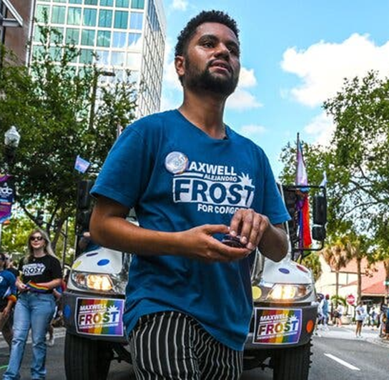
Advocacy in 2023: Who to Engage
Connect with new and returning elected officials, across all levels of government
Encourage your friends, relatives, or members to find their elected officials via online tools
Build and maintain relationships with staff -- District and Legislative
Sign up for newsletters and follow elected officials on social media
AmericansForTheArts.org
ArtsActionFund.org
@Americans4Arts
@ArtsActionFund
Notes:
Josh Notes: You need to be doing this NOW. Don't wait until swearing in; invite them to holiday parties or an introductory session
Online tools: Congress, or state govs have a "find my legislator" webpage.
More local you go the easier to get access and build relationships.
Don’t assume they know anything about the arts and culture. Do research to see if they have any arts background either them or family. Set up meetings because you are the subject matter expert, you share your knowledge to break down any preconceived notions. Rely on constituents to make informed decisions at state and local level bc no/limited staff, need data and stories to hone points.

Slide 38
Advocacy in 2023: When to Engage
Key Dates for Federal Advocacy
December 6: Runoff election for one Georgia Senate seat
January 3: Swearing-in day for the 118th Congress
March 2023: Administration budget recommendations expected
May-June 2023: The U.S. House Appropriations subcommittees expected to markup their bills
Key Dates for State Advocacy
Most session begin in early January
Majority of sessions are out by the end of Summer
AmericansForTheArts.org
ArtsActionFund.org
@Americans4Arts
@ArtsActionFund
Notes:
Only 7 year round legislatures
Some only meet every other year (Texas)
Don't forget your elections are ongoing; likely sworn-in in January

Slide 39
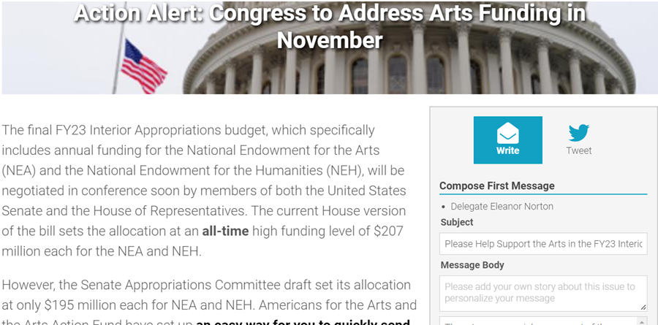
Advocacy in 2023: How to Engage
Send messages through the VoterVoice platform
Join the Arts Action Fund
Join your local arts advocacy organization
Send a congratulatory letter to your elected officials (ASAP)
Invite elected officials to events early and often
AmericansForTheArts.org
ArtsActionFund.org
@Americans4Arts
@ArtsActionFund
Notes:
Everyone can write and individual letter to Congress via our VV on our/ AAF website.
In your message, introduce your org and the arts in their district.
Meetings can be anywhere, not exclusively in office space. Organize a new member welcome event if possible, allowing elected officials to engage with your members/donors/constituents.
Set up meeting with staff
Ask key new members to request specific committee assignments
Arts Advocacy Days

Slide 40
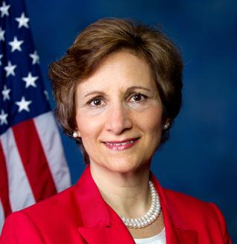
Rep. Suzanne Bonamici (D-OR-1)
Chair, Congressional STEAM Caucus
AmericansForTheArts.org
ArtsActionFund.org
@Americans4Arts
@ArtsActionFund

